Slide 1
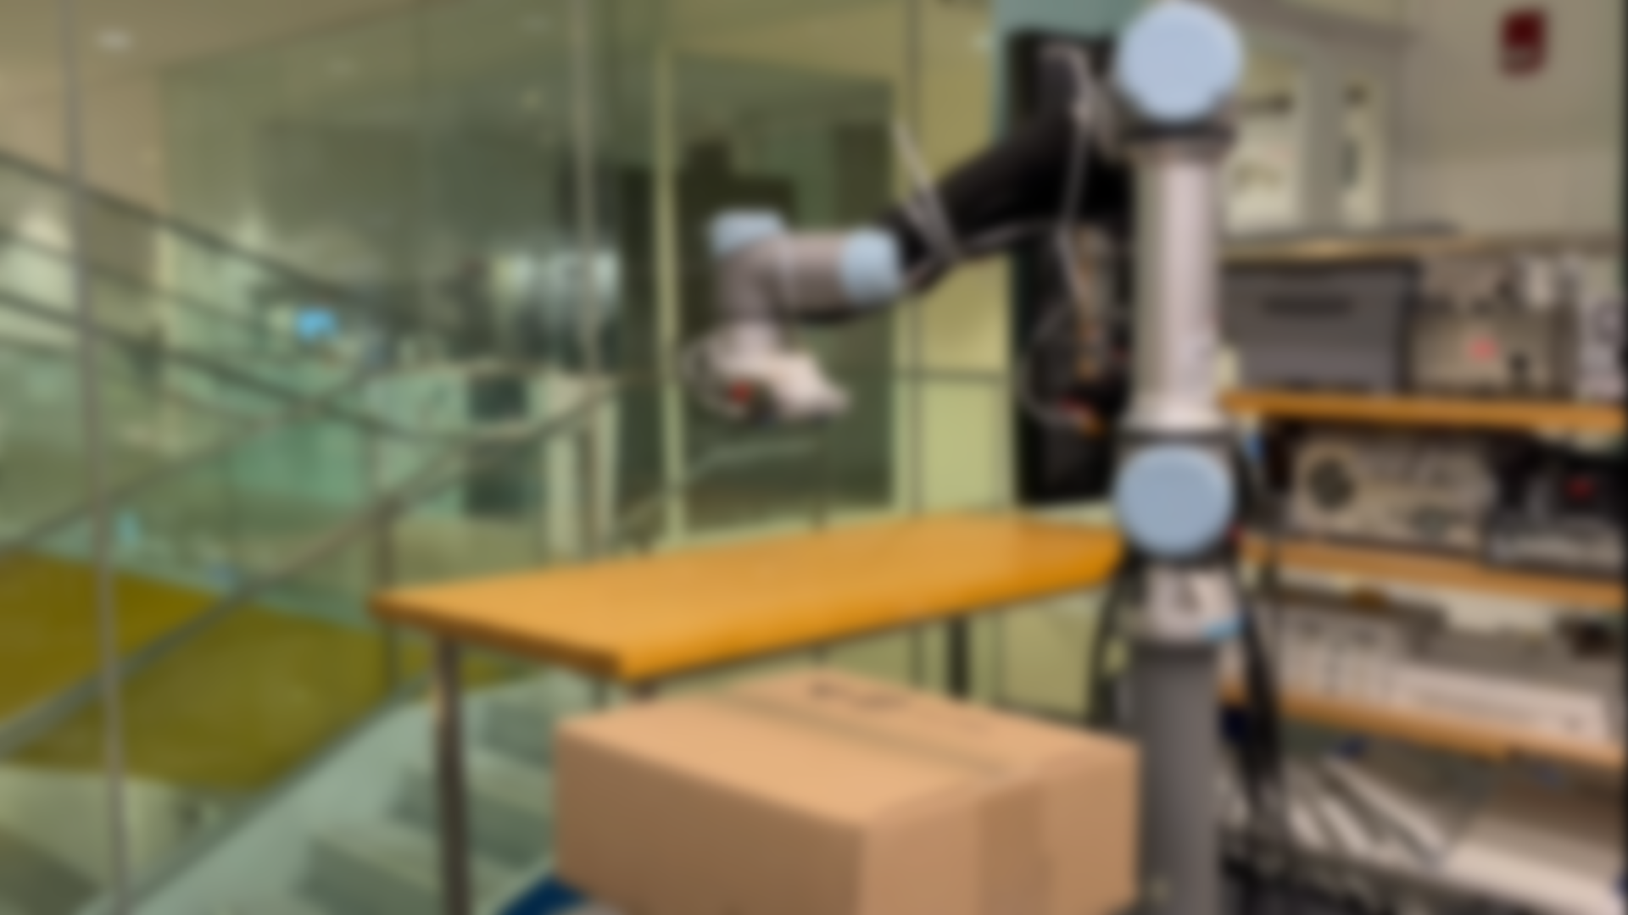

Non-Line-of-Sight 3D Object Reconstruction via mmWave Surface Normal Estimation
Laura Dodds, Tara Boroushaki, Kaichen Zhou, Fadel Adib
Cartesian
Systems

Slide 2
Can we enable high-accuracy non-line-of-sight 3D object reconstruction with millimeter-waves?
Notes:
NLOS mmWave reconstruction is an problem of huge interest in our community In this project, our goal is to ask,

Slide 3
Can we enable high-accuracy non-line-of-sight
3D object reconstruction with millimeter-waves?

Slide 4
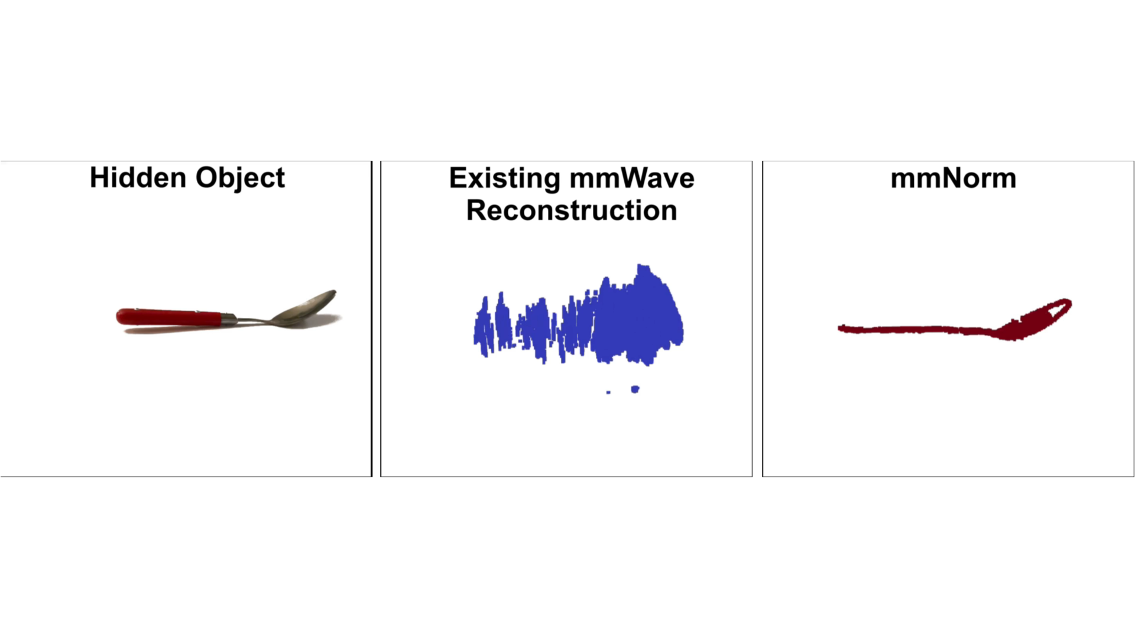
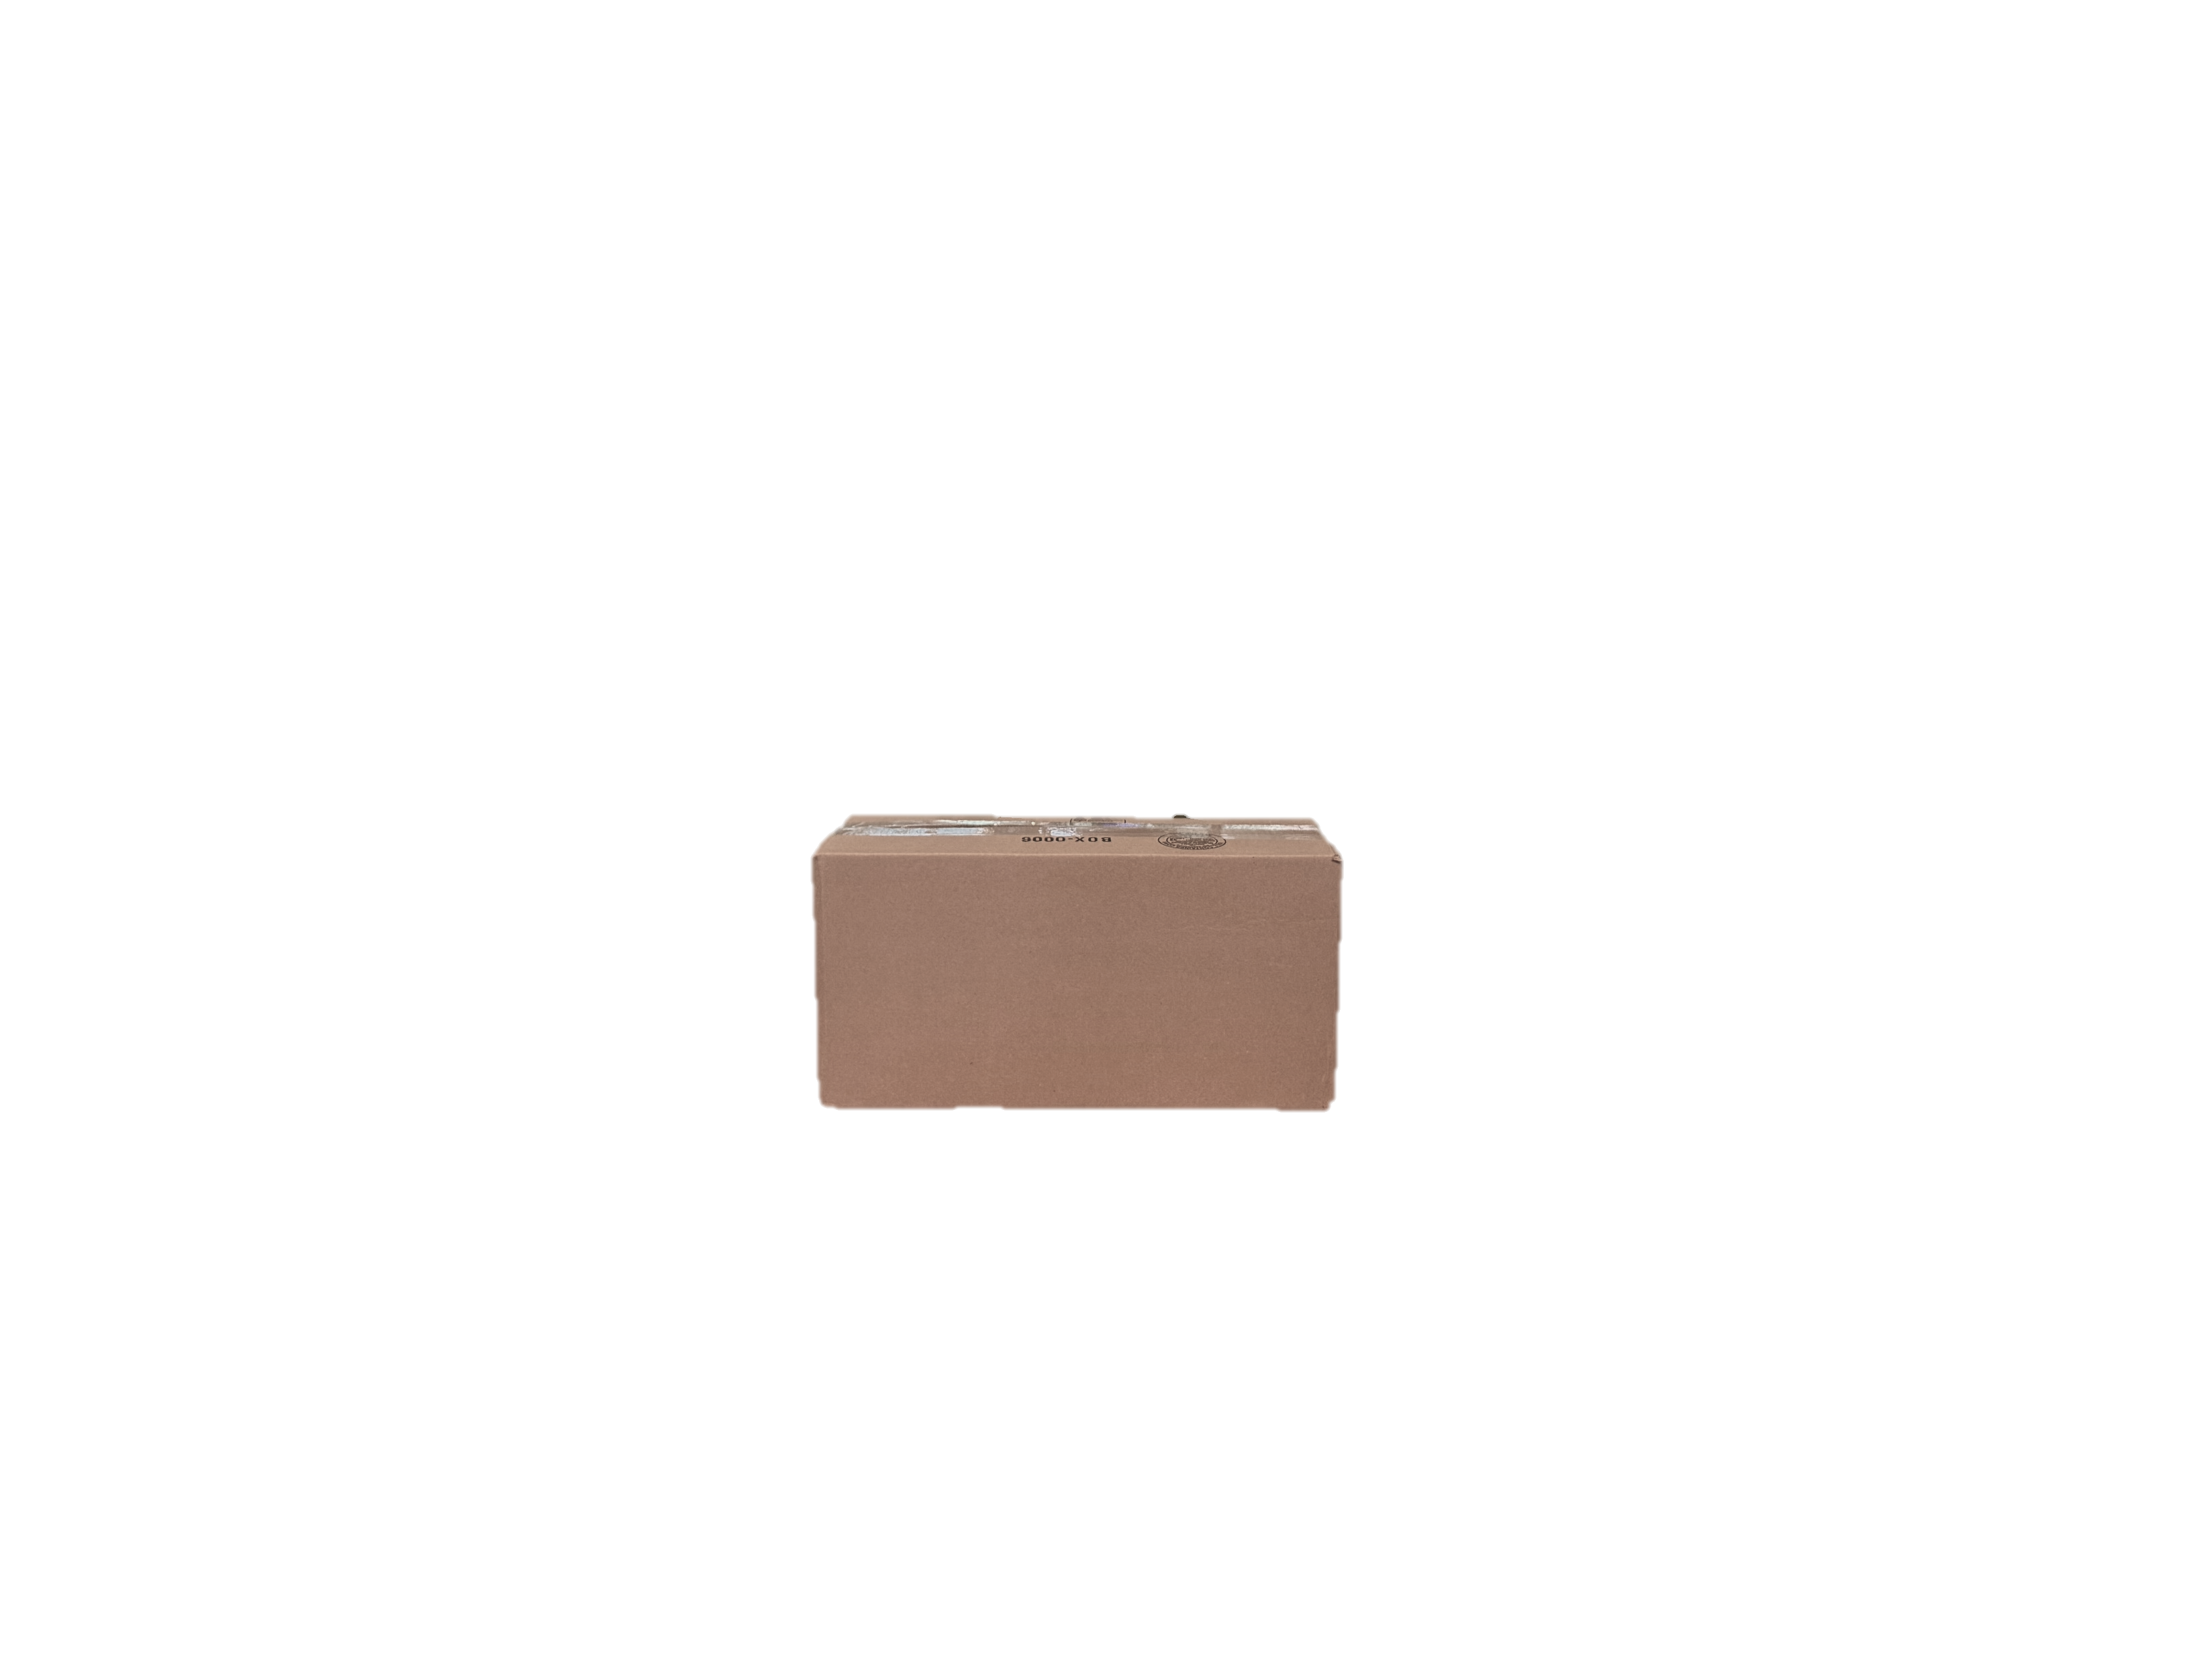
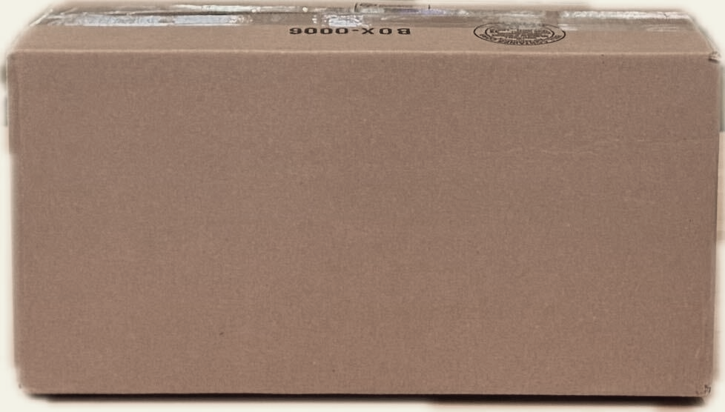
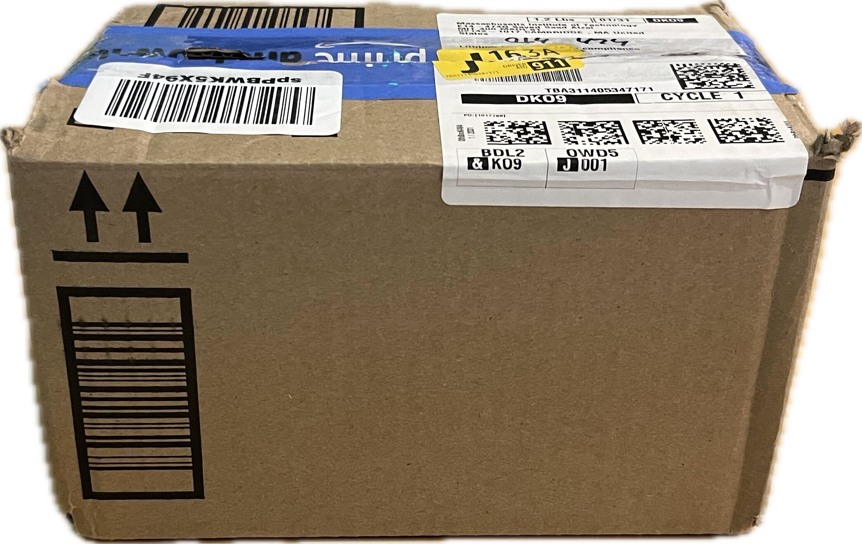
Can we enable high-accuracy non-line-of-sight
3D object reconstruction with millimeter-waves?
*
* Mobicom ‘24

Slide 5
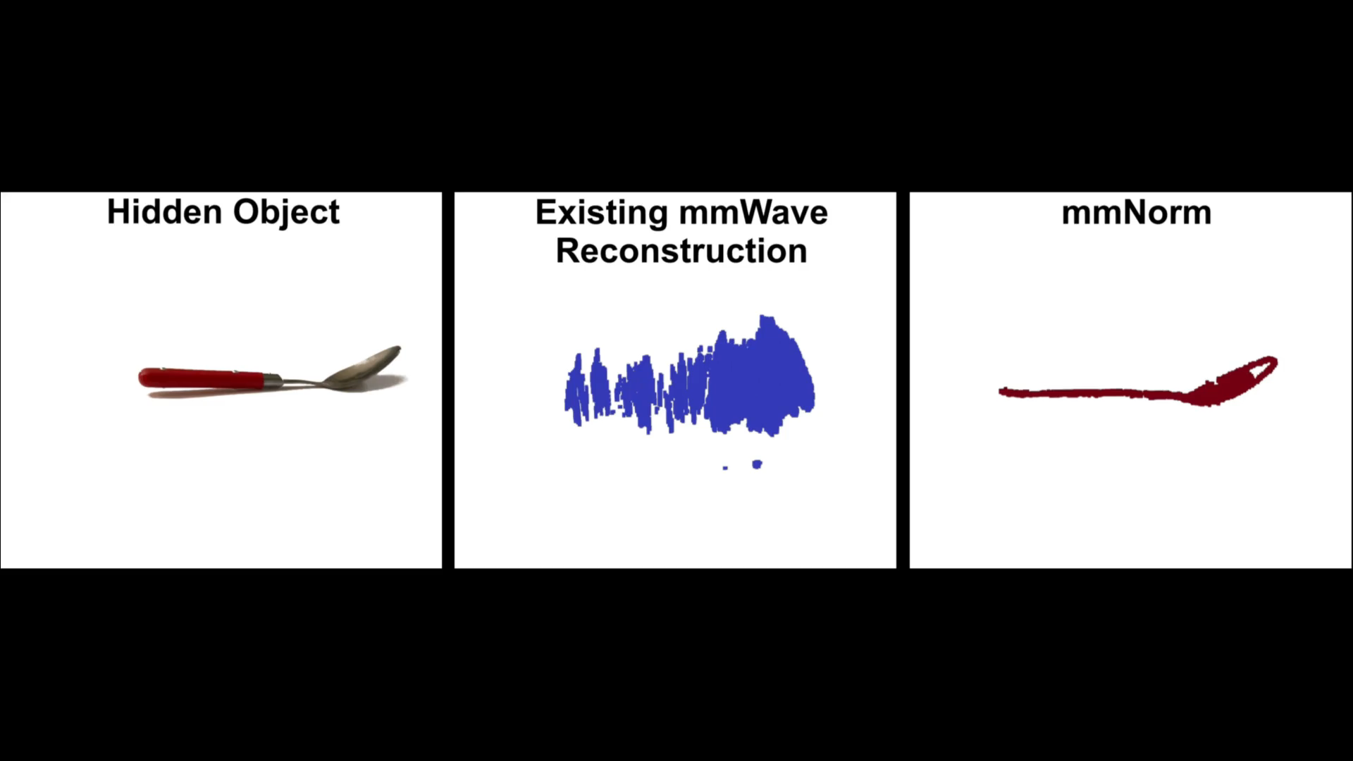
Can we enable high-accuracy non-line-of-sight
3D object reconstruction with millimeter-waves?
*
* Mobicom ‘24

Slide 6
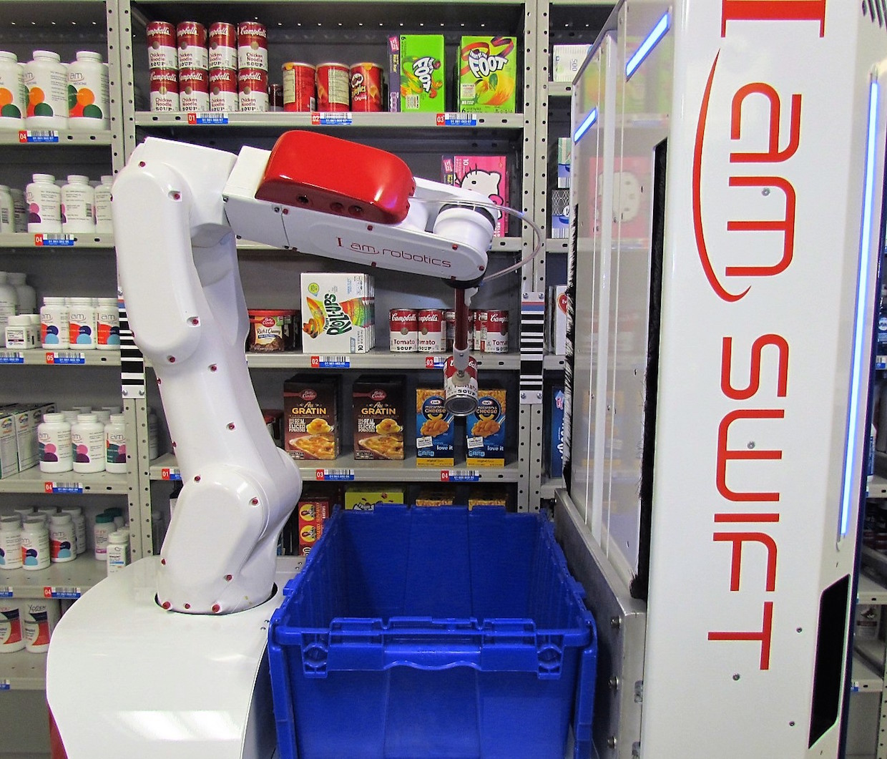
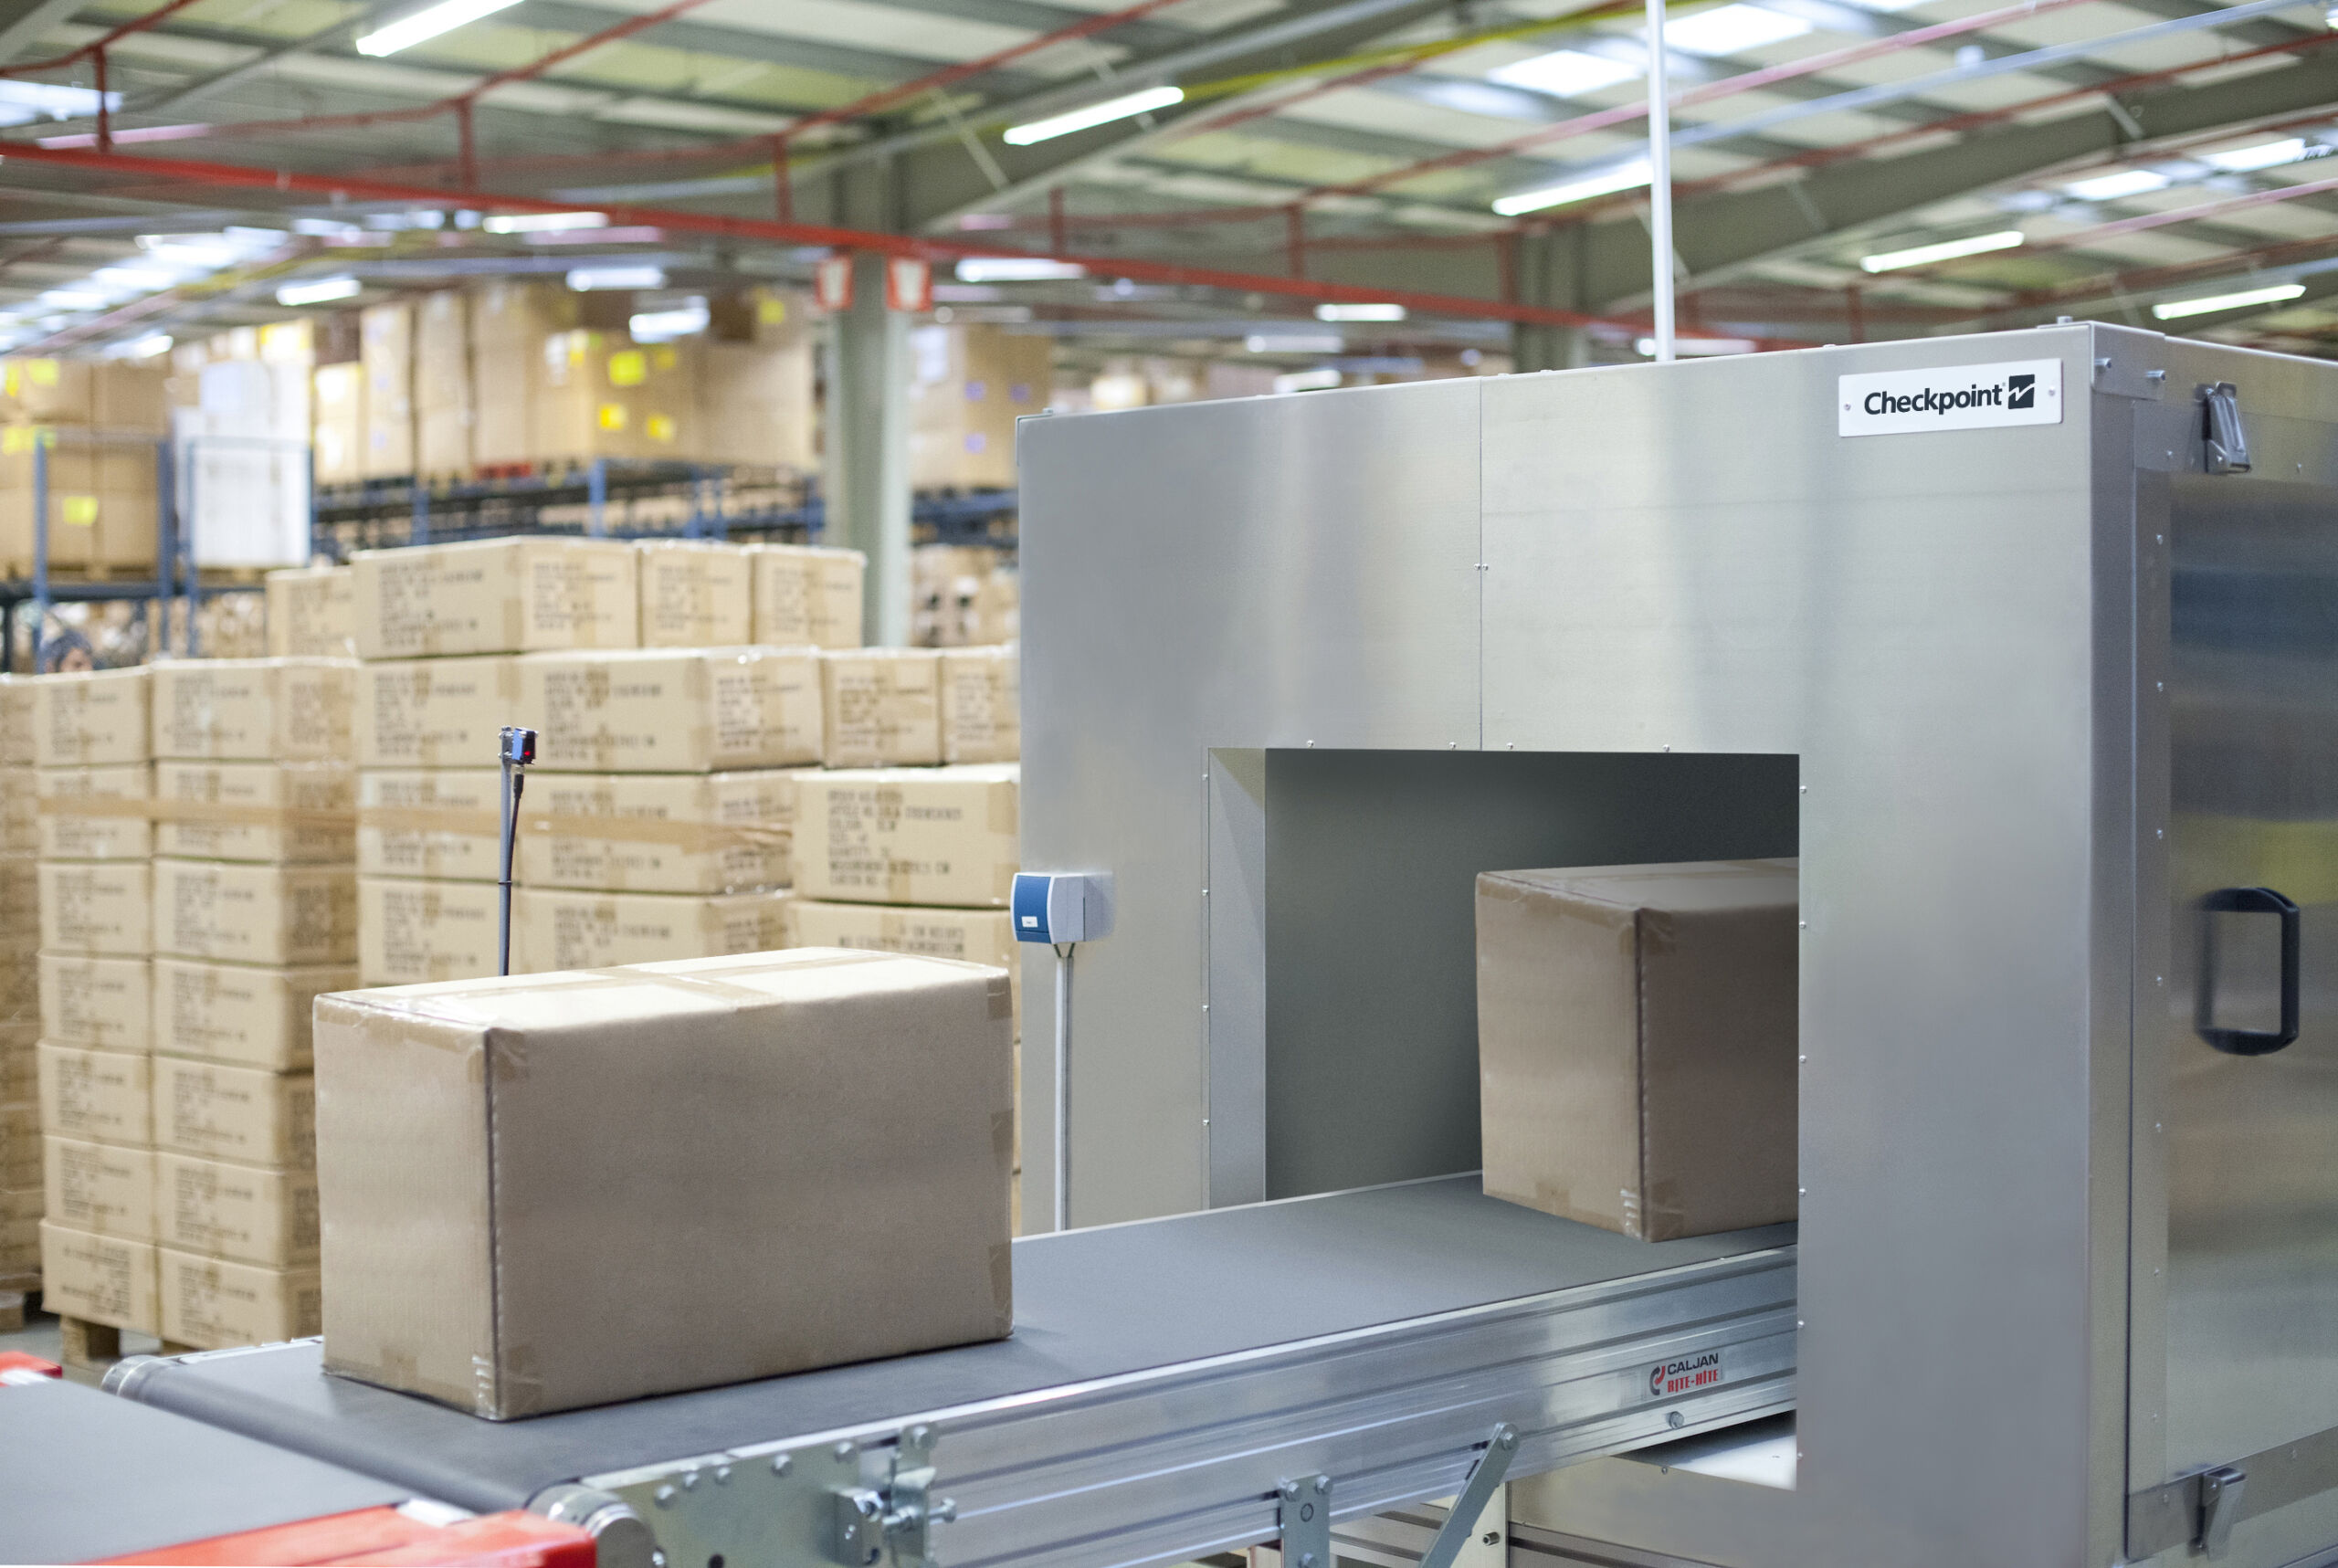
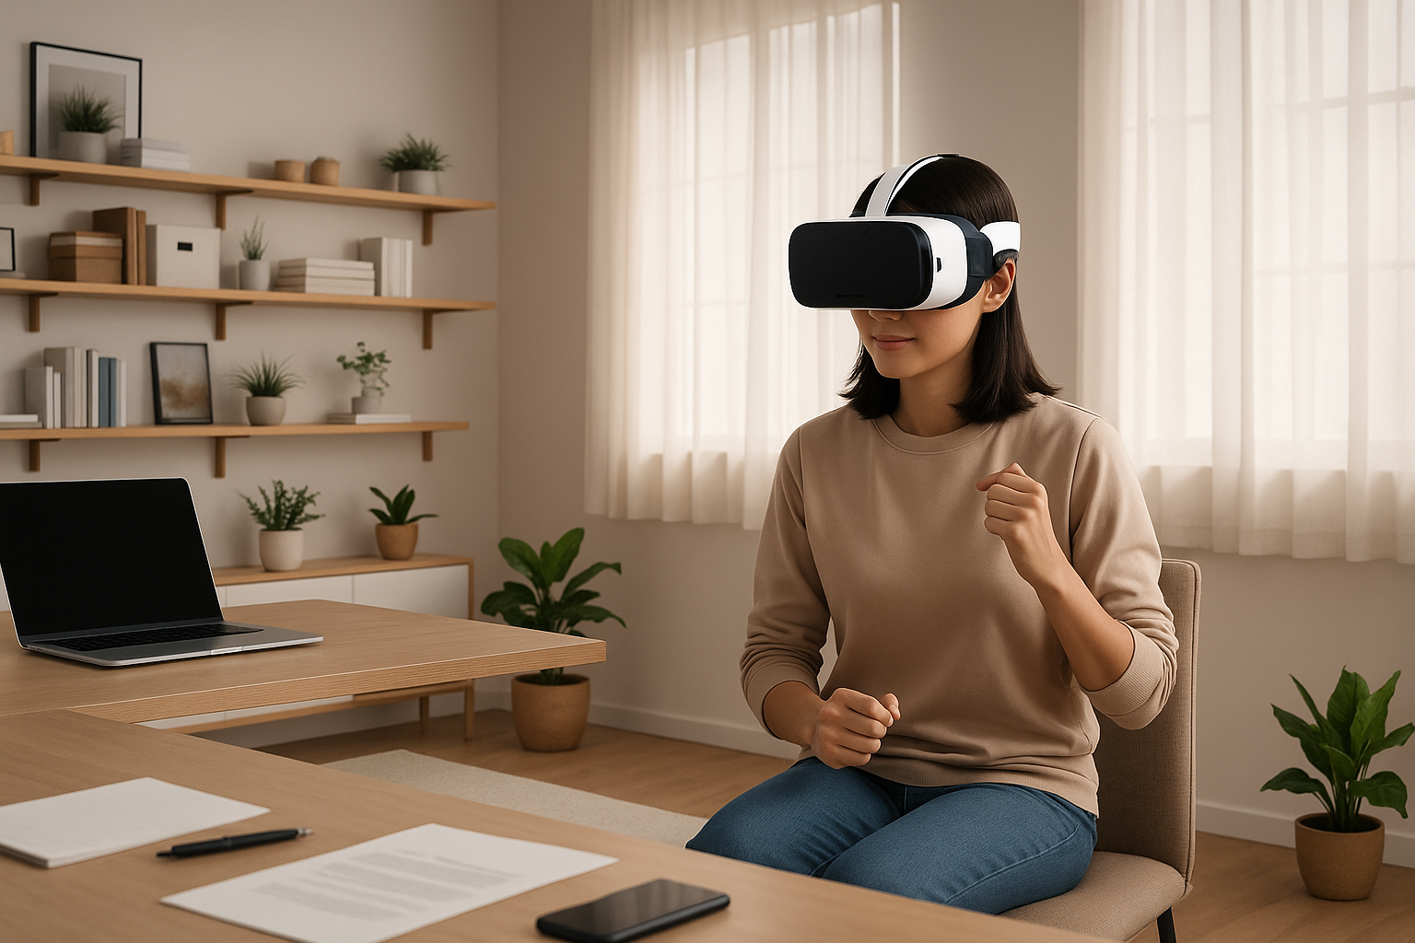

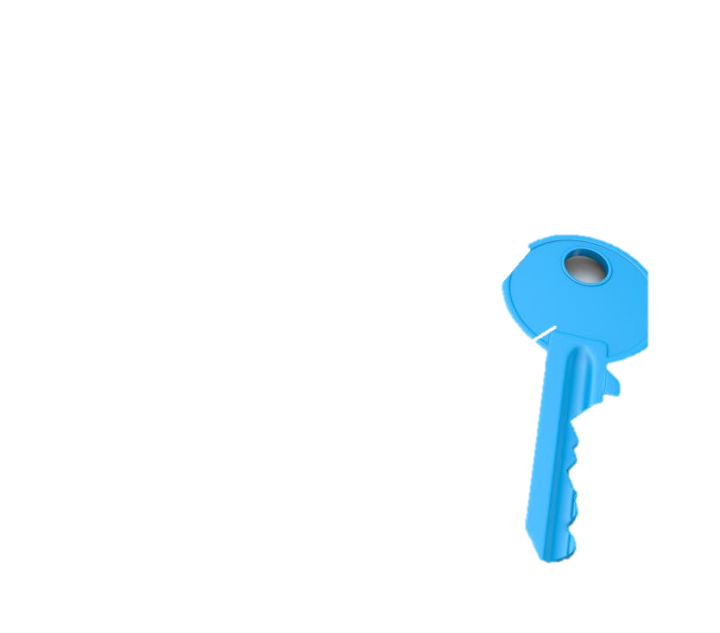
High-Accuracy Non-Line-of-Sight 3D Reconstruction has Many Applications
Robotics
Shipping & Logistics
Augmented Reality
camera view static (gone), robot scanning (v fast or only partial), - camera view gets bigger, open box - blur to spoon gets smaller
Add baseline
Add ours
Spin all 3

Slide 7
mmNorm
A new & highly-accurate method for 3D object reconstruction leveraging an entirely first-principles based approach
Introduces techniques for mmWave Surface Normal Estimation and mmWave Structural Isosurface Optimization
Achieves a qualitative leap in mmWave reconstruction over state-of-the-art methods

Slide 8

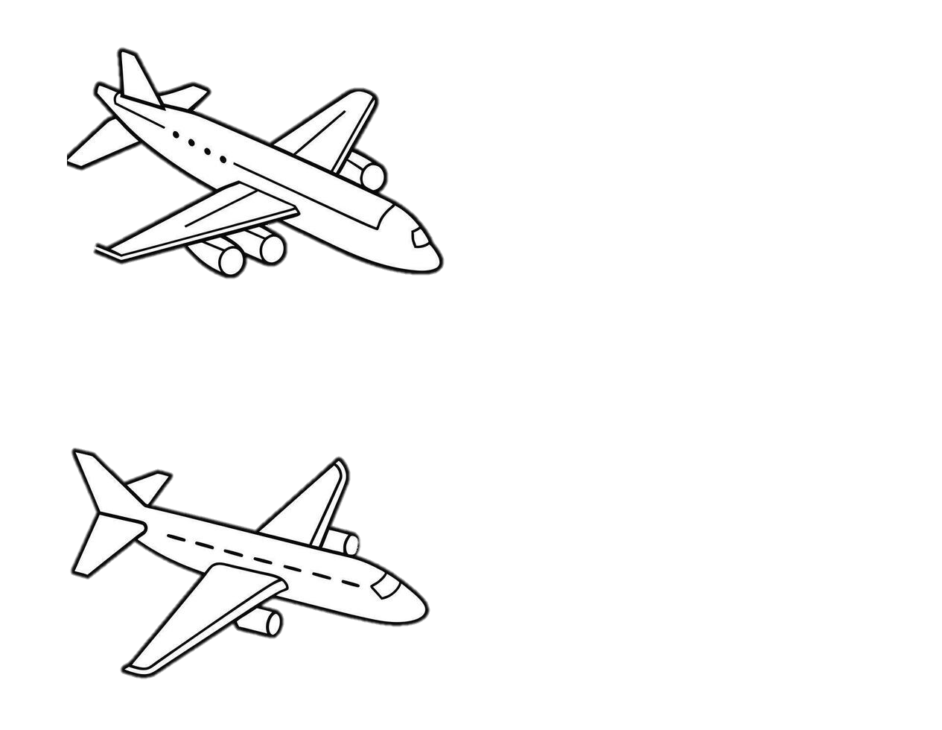

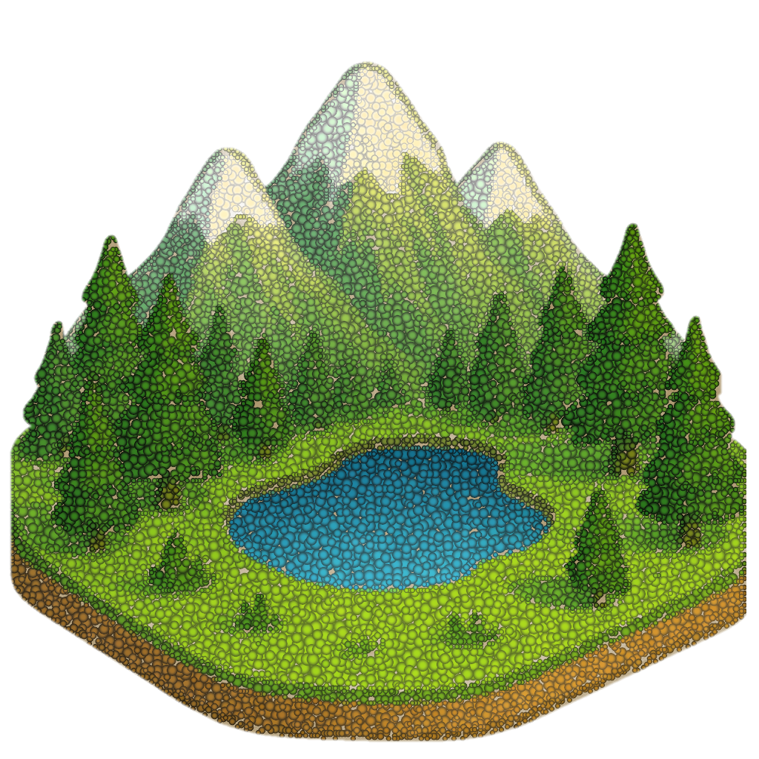
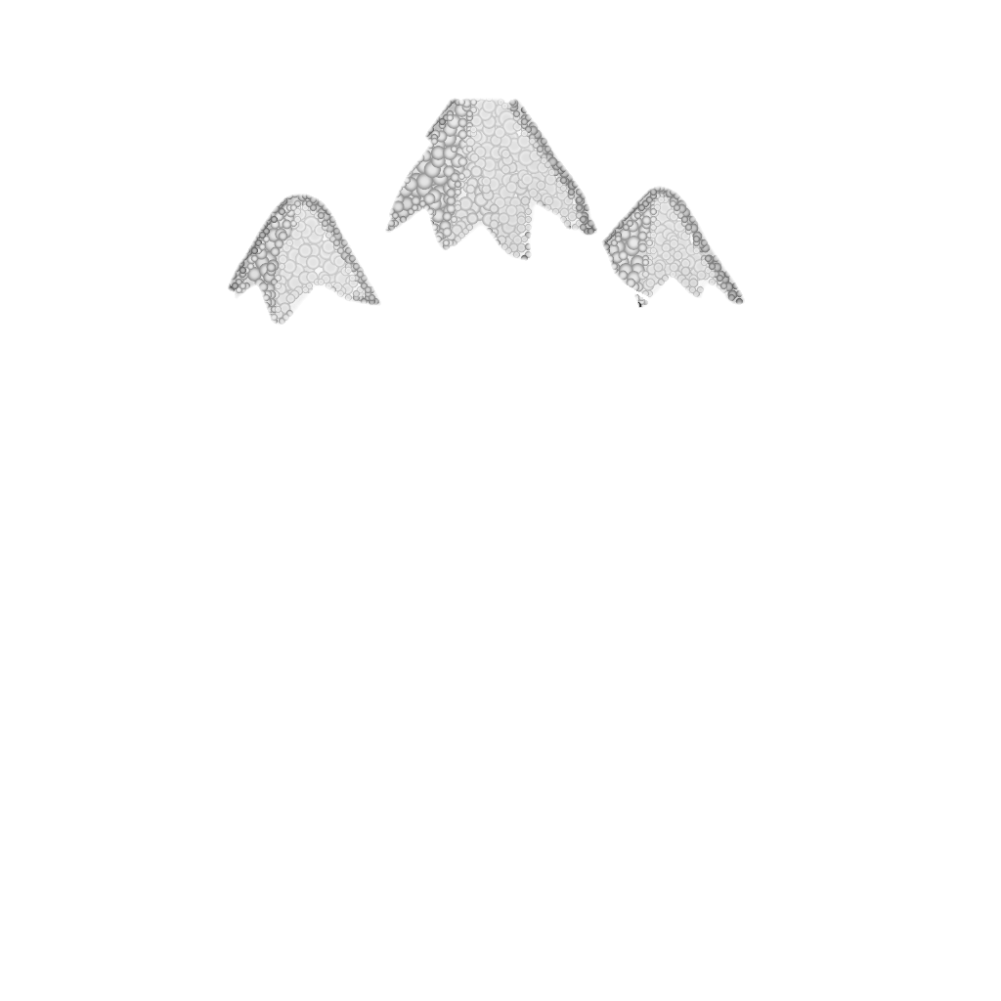

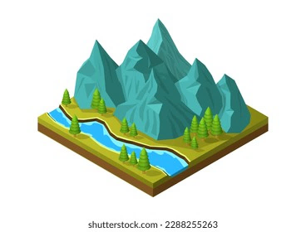



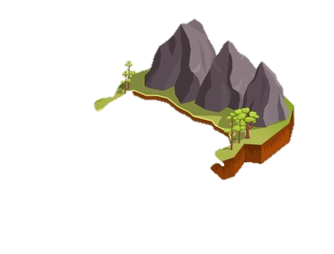
How do existing methods perform 3D reconstruction?
Elevation
Airplane with
Radar
Azimuth
Range
2D Synthetic Aperture
Synthetic Aperture
Produce a 3D SAR Image
Generate 3D point cloud
TomoSAR, 1997
Notes:
Now before I tell you how mmNorm works, it is helpful for me to first explain how existing methods perform 3d reconstruction. Now for the most part, we as a community have been performing 3D reconstruction in the same way for decades. For example, it startwed when we wanted to reconstruct large scale scenese such as this mountain scene. So we as a community mounted a radar onto an airplane or satellite, and have the airplane fly over the scene, continuously collecting measurements to produce a synthetic aperture. Then, we can have the same airplane fly over the scene multiple times to expand our synthetic aperture into a 2D synthetic aperture.
This allows us to measure the range, azimuth, and elevation to different reflectors in the scene. With this, we can produce a 3D SAR image, and use this to generate a 3D point cloud.

Slide 9
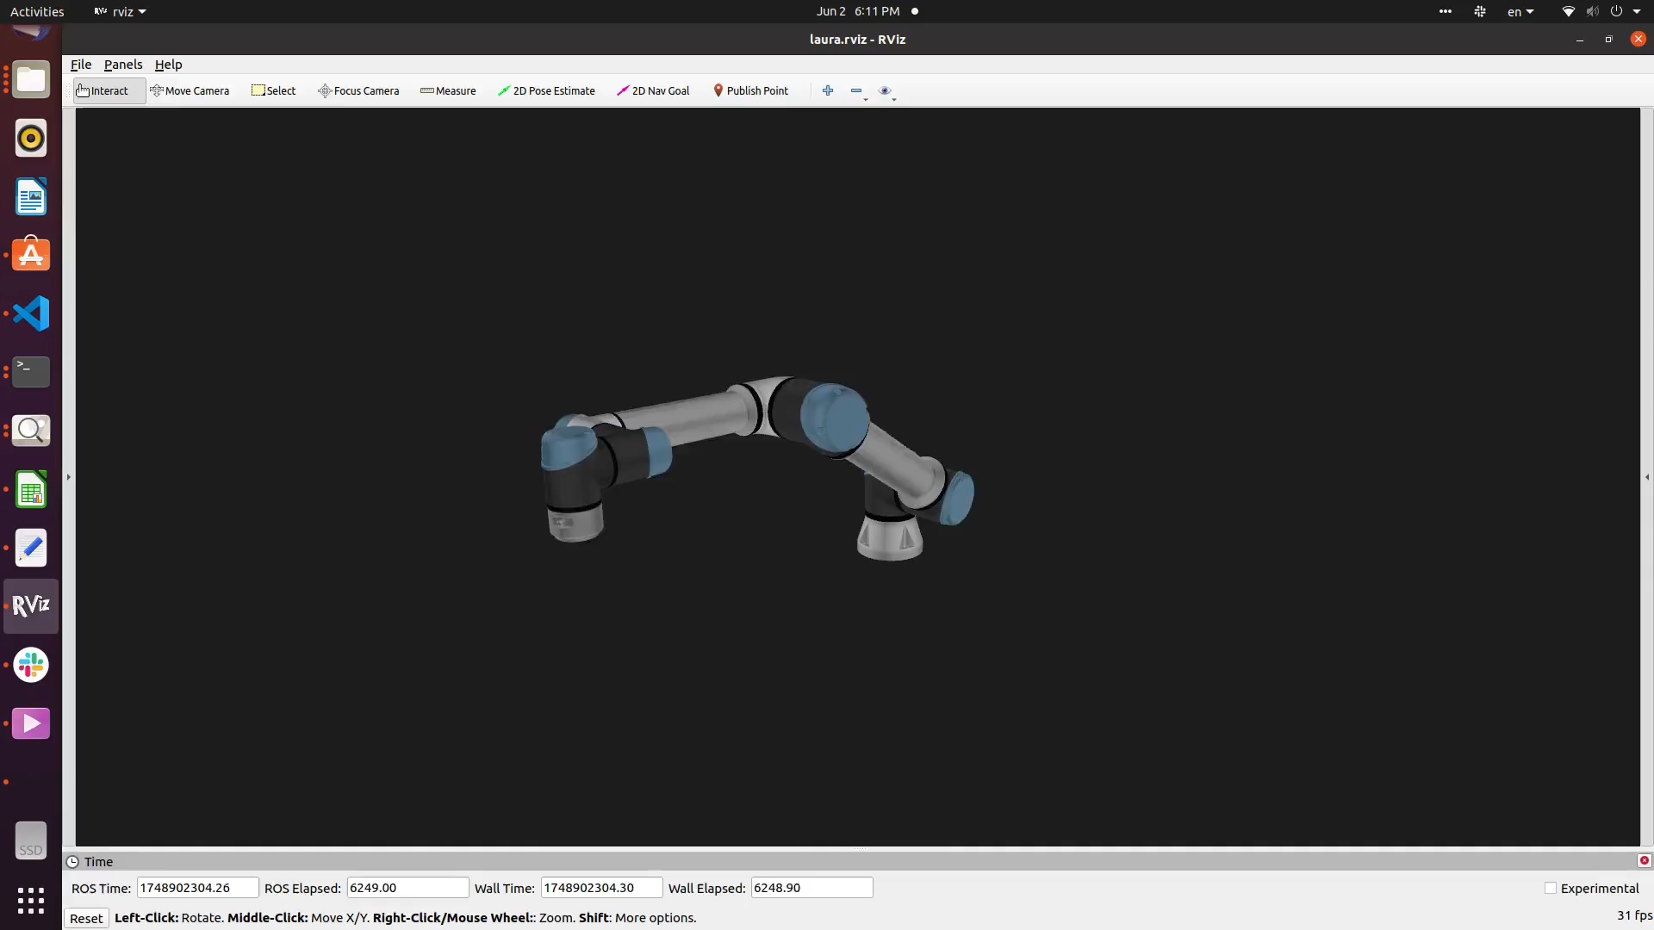
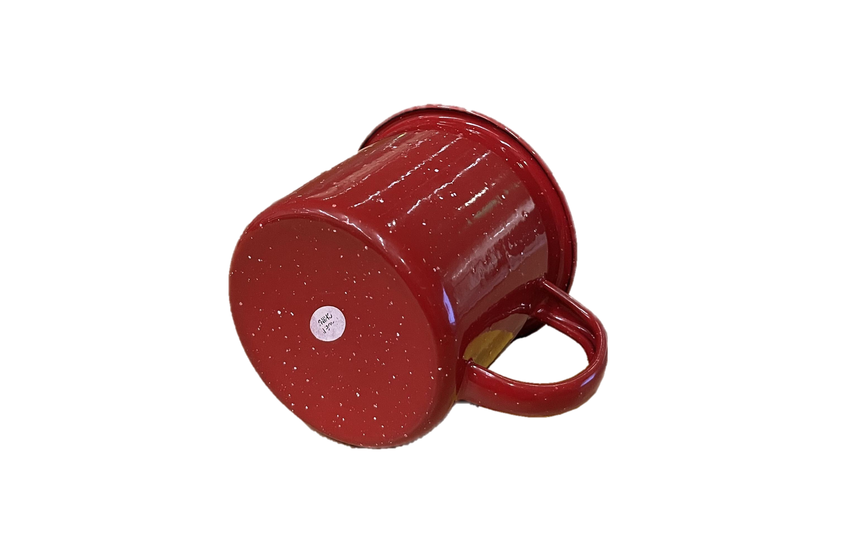
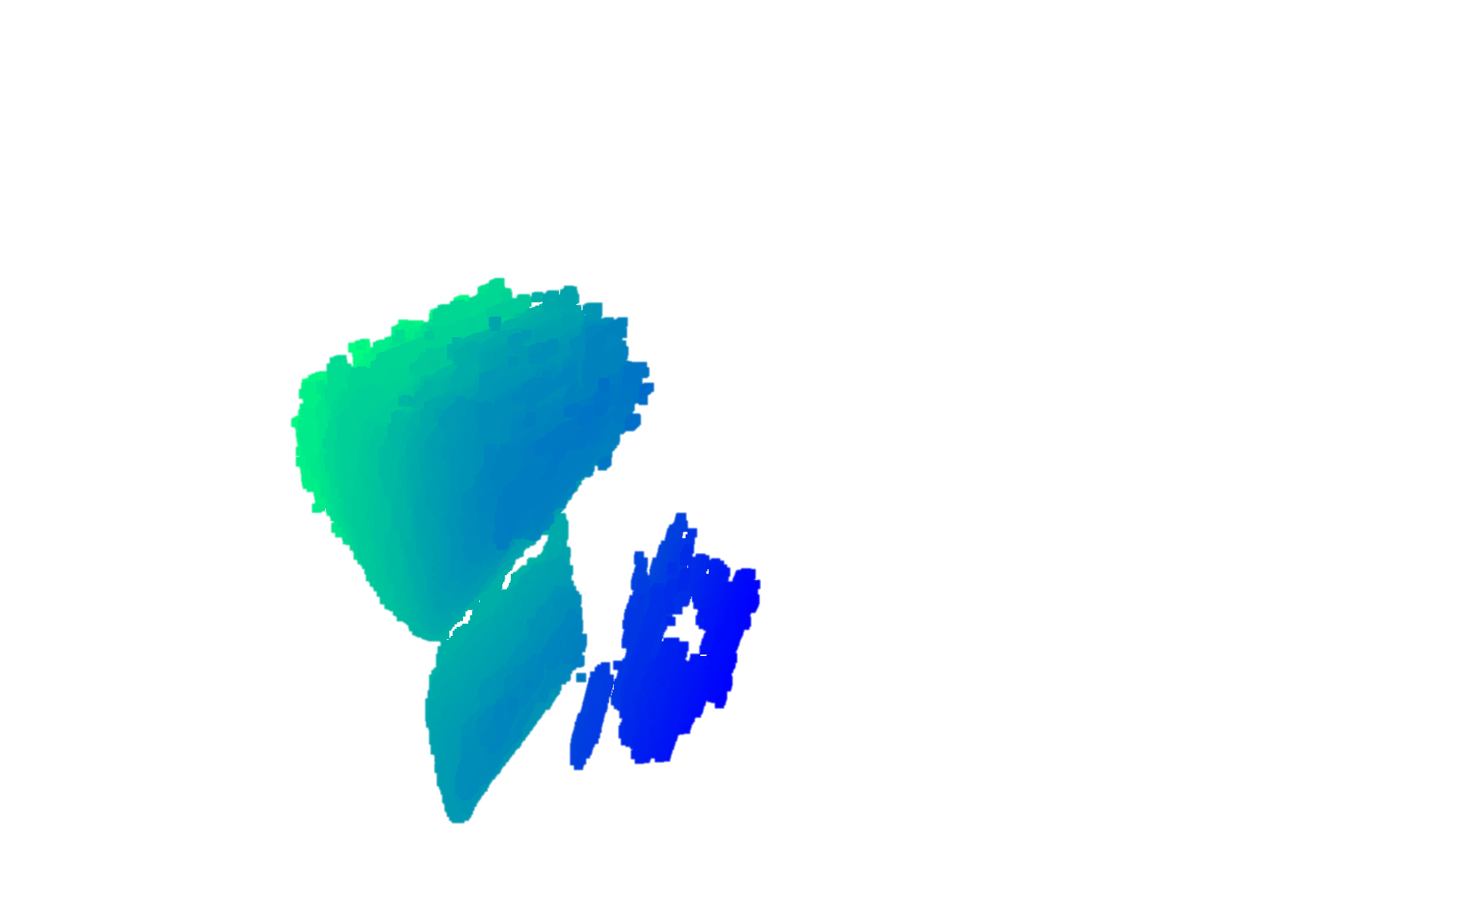
How do existing methods perform 3D reconstruction?
Produce a 3D SAR Image
Object to
Reconstruct
Generate 3D point cloud
Reconstruction quality is limited by SAR resolution (i.e., bandwidth)
IMWUT ‘23, Mobicom ‘24
Notes:
Now when we as a community wanted to move from these large scale scenes to much smaller objects, we applied almost the exact same approach. For example, to reconstruct this mug here, past work has attached a radar to a robot or linear stage. The robot then moves the radar, again collecting a 2D synthetic aperture. Again, we can produce a 3D SAR image, and use this to generate a 3D point cloud.
But this time, there is a problem. Unlike before, where we were reconstructing massive mountain scenes, we are now trying to reconstruct a tiny mug. This means that now our reconstruction quality is severely limited by our SAR resolution, which in this case is limited by our commercially available bandwidth.

Slide 10
How do existing methods perform 3D reconstruction?
Real-World
3D Point Cloud
Reconstruction quality is limited by SAR resolution (i.e., bandwidth)

Slide 11
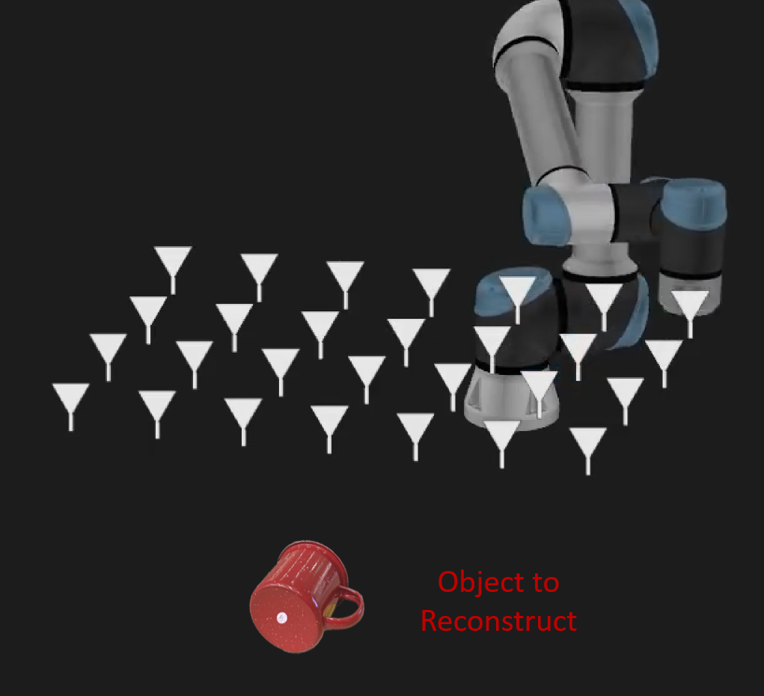
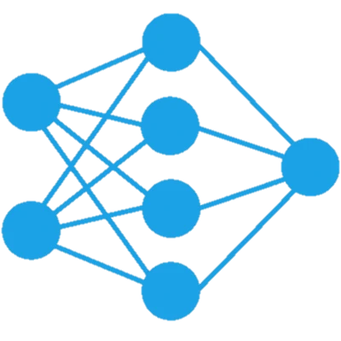
How do existing methods perform 3D reconstruction?
First-Principles Methods
Machine-Learning Methods
Points are spread due to limited resolution
3D Model
We need a fundamentally new approach for
mmWave 3D object reconstruction
Requires Significant Training Data
Our Idea: Directly estimate the curvature of the object
Reconstruction quality is limited by SAR resolution (i.e., bandwidth)
Typically operate on very small subset of objects
CVPR ‘20, Mobicom ‘24

Slide 12
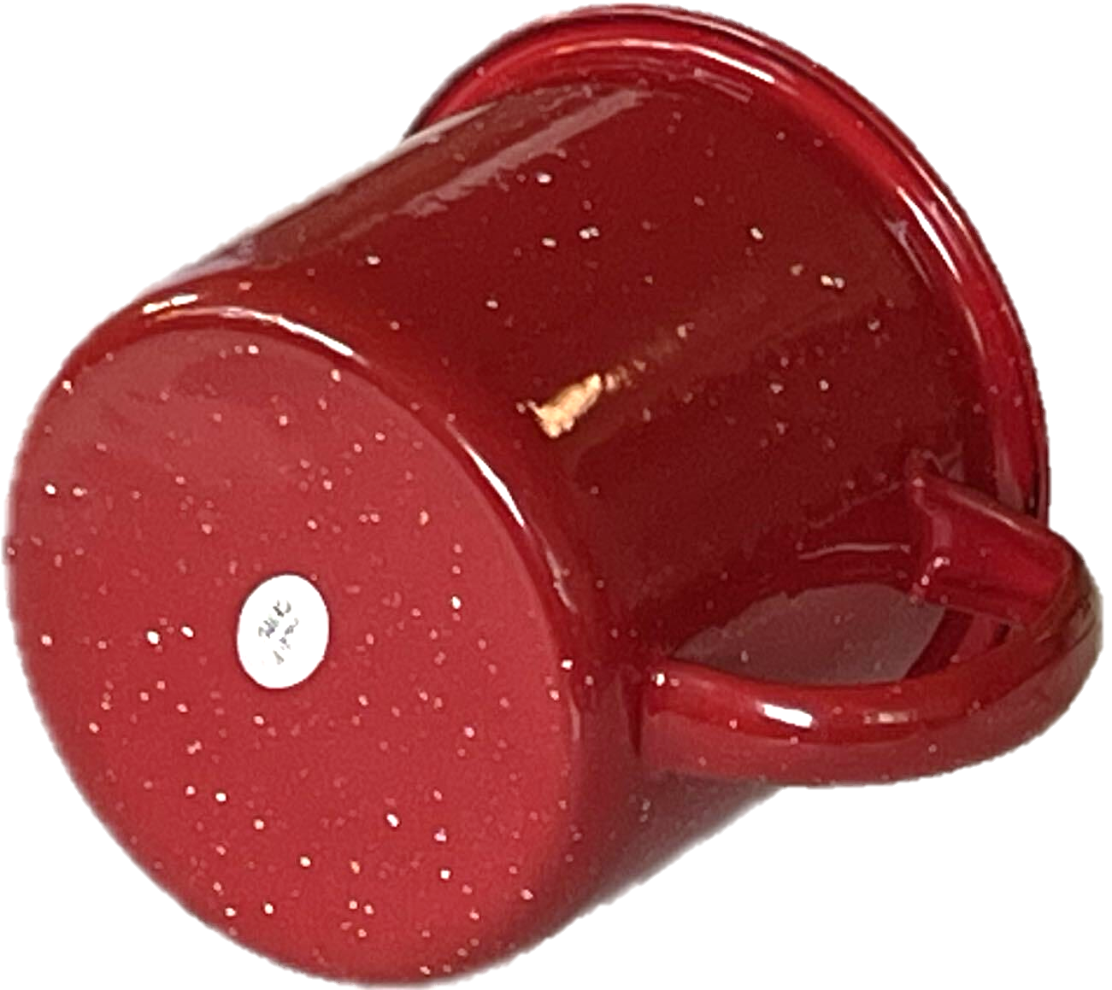
Our Idea: Directly estimate the curvature of the object
by estimating surface normal vectors
Surface
Normal
Vector

Slide 13
Our Idea: Directly estimate the curvature of the object
by estimating surface normal vectors

Slide 14
Our Idea: Directly estimate the curvature of the object
by estimating surface normal vectors
Surface Normal Vector Field
Synthetic
Aperture

Slide 15
Our Idea: Directly estimate the curvature of the object
by estimating surface normal vectors
1. Normal Field Estimation

Slide 16
Our Idea: Directly estimate the curvature of the object
by estimating surface normal vectors
1. Normal Field Estimation
2. Multiple Valid Surfaces

Slide 17
Our Idea: Directly estimate the curvature of the object
by estimating surface normal vectors
1. Normal Field Estimation
2. Multiple Valid Surfaces
3. Single Unifying
Function
4. Isosurface
Optimization
Relative Signed Distance Function
Isosurface: Surface of constant value

Slide 18
Our Idea: Directly estimate the curvature of the object
by estimating surface normal vectors
1. Normal Field Estimation
2. Multiple Valid Surfaces
3. Single Unifying
Function
4. Isosurface
Optimization
Relative Signed Distance Function
Isosurface: Surface of constant value
Final Surface Estimate

Slide 19
Our Idea: Directly estimate the curvature of the object
by estimating surface normal vectors
Synthetic
Aperture

Slide 20
Our Idea: Directly estimate the curvature of the object
by estimating surface normal vectors
Synthetic
Aperture

Slide 21
Our Idea: Directly estimate the curvature of the object
by estimating surface normal vectors
Synthetic
Aperture
Object Surface

Slide 22
mmWave signals experience primarily specular reflections
Synthetic
Aperture
Signal Received
No Signal Received
Object Surface

Slide 23
At a given voxel, what direction is the surface normal?
Lets say one of these antennas receive a reflection from this voxel
Possible Surface Normals
Due to specularity, these normal do not produce reflections towards the aperture
Voxel

Slide 24
At a given voxel, what direction is the surface normal?
v₁
v₂
v₃
v₄
v₅
v₆
v₇
Voxel
Reflection amplitude acts as a vote

Slide 25
At a given voxel, what direction is the surface normal?
v₁
v₂
v₃
v₄
v₅
v₆
v₇
Reflection amplitude acts as a vote

Slide 26
At a given voxel, what direction is the surface normal?
Example 2
Example 1
v₁
v₂
v₃
v₄
v₅
v₆
v₇
Reflection amplitude acts as a vote

Slide 27
At a given voxel, what direction is the surface normal?
Example 2
Example 1
v₁
v₂
v₃
v₄
v₅
v₆
v₇
Reflection amplitude acts as a vote

Slide 28
At a given voxel, what direction is the surface normal?
Example 2
Example 1
v₁
v₂
v₃
v₄
v₅
v₆
v₇
v₁
v₂
v₃
v₄
v₅
v₆
v₇
Reflection amplitude acts as a vote

Slide 29
At a given voxel, what direction is the surface normal?
Example 2
Example 1
v₁
v₂
v₃
v₄
v₅
v₆
v₇
v₁
v₂
v₃
v₄
v₅
v₆
v₇
Reflection amplitude acts as a vote

Slide 30

At a given voxel, what direction is the surface normal?
v₁
v₂
v₃
v₄
v₅
v₆
v₇
Weighted Sum
$$\overset{⃑}{n}\left(u\right)=\sum_{k=0}^{N}{v_{k} \frac{p_{k}−u}{|\left|p_{k}−u\right||}}$$
arriving from this voxel in SAR image
Reflection amplitude acts as a vote

Slide 31
How do we compute the voting function?
v₁
v₂
v₃
v₄
v₅
v₆
v₇
Weighted Sum
$$\overset{⃑}{n}\left(u\right)=\sum_{k=0}^{N}{v_{k} \frac{p_{k}−u}{|\left|p_{k}−u\right||}}$$
arriving from this voxel in SAR image
Reflection amplitude acts as a vote

Slide 32








How do we compute the voting function?
Reflection amplitude acts as a vote
arriving from this voxel in SAR image
Individual
Antenna
Value
$$\sum_{i=1}^{M}{}$$
$$e^{{j2πd(v,k)}/{λ_{i}}}$$
$$I(k)=$$
$$h\left(i,k\right)$$
Sum across
frequency
Received
signal
Expected
signal
$$\sum_{k=1}^{N}{}$$
$$S$$
$$=$$
$$I(k)$$
mmWave
Voxel Value
Sum across
antennas
Individual
Antenna
Values

Slide 33









How do we compute the voting function?
Reflection amplitude acts as a vote
arriving from this voxel in SAR image
mmWave
Voxel
Value
Q
Antenna 1 Value
Antenna 2 Value
Large Projection Magnitude
I
Small Projection Magnitude
We repeat this at every voxel in space to produce a normal vector field
$$\sum_{i=1}^{M}{}$$
$$\sum_{k=1}^{N}{}$$
$$e^{{j2πd(v,k)}/{λ_{i}}}$$
$$I(k)$$
$$I(k)=$$
$$h\left(i,k\right)$$
$$S$$
$$=$$
$$v_{k}=|proj\left(I\left(k\right), S\right)|$$
Notes:
Arrow is big but proj is small
Change style?
Put in plot with background of white and grid
And change angle

Slide 34
How do we compute the voting function?
Reflection amplitude acts as a vote
arriving from this voxel in SAR image
Q
We repeat this at every voxel in space to produce a normal vector field
Small Projection Magnitude
I
Antenna 1 Value
Antenna 2 Value
Large Projection Magnitude
mmWave
Voxel
Value
$$\sum_{i=1}^{M}{}$$
$$\sum_{k=1}^{N}{}$$
$$e^{{j2πd(v,k)}/{λ_{i}}}$$
$$I(k)$$
$$I(k)=$$
$$h\left(i,k\right)$$
$$S$$
$$=$$
$$v_{k}=|proj\left(I\left(k\right), S\right)|$$
Notes:
Arrow is big but proj is small
Change style?
Put in plot with background of white and grid
And change angle

Slide 35









How do we compute the voting function?
Reflection amplitude acts as a vote
arriving from this voxel in SAR image
Q
Small Projection Magnitude
Antenna 1 Value
I
We repeat this at every voxel in space to produce a normal vector field
$$\sum_{i=1}^{M}{}$$
$$\sum_{k=1}^{N}{}$$
$$e^{{j2πd(v,k)}/{λ_{i}}}$$
$$I(k)$$
Large Projection Magnitude
$$I(k)=$$
$$h\left(i,k\right)$$
$$S$$
$$=$$
Antenna 2 Value
mmWave
Voxel
Value
Voting Function: $v_{k}=\frac{ℜ\left\{I\left(k\right)\right\}ℜ\left\{S\right\}+ℑ\left\{I\left(k\right)\right\}ℑ\{S\}}{|\left|S\right||}$

Slide 36
Our Idea: Directly estimate the curvature of the object
by estimating surface normal vectors
1. Normal Field Estimation
2. Multiple Valid Surfaces
3. Single Unifying
Function
4. Isosurface
Optimization
Relative Signed Distance Function
Isosurface: Surface of constant value
Final Surface Estimate

Slide 37


How can we capture all ambiguous surfaces in one function?
Computer Graphics Community
mmNorm
Signed Distance Function
Normal Vector
Field
Positive values
0 at surface of object
Negative values
$$\frac{d}{dx}$$
$$\int{dx}$$
Normal Vector
Field
Relative Signed Distance Function
Unknown constant offset

Slide 38
How can we capture all ambiguous surfaces in one function?
Computer Graphics Community
mmNorm
Signed Distance Function
Normal Vector
Field
Positive values
0 at surface of object
Negative values
$$\frac{d}{dx}$$
$$\int{dx}$$
Normal Vector
Field
Relative Signed Distance Function
Unknown constant offset

Slide 39
How can we capture all ambiguous surfaces in one function?
Computer Graphics Community
mmNorm
Signed Distance Function
Normal Vector
Field
Positive values
0 at surface of object
Negative values
$$\frac{d}{dx}$$
$$\int{dx}$$
Normal Vector
Field
Relative Signed Distance Function
Unknown constant offset

Slide 40
How can we capture all ambiguous surfaces in one function?
Computer Graphics Community
mmNorm
Signed Distance Function
Normal Vector
Field
Positive values
0 at surface of object
Negative values
$$\frac{d}{dx}$$
$$\int{dx}$$
Normal Vector
Field
Relative Signed Distance Function
Unknown constant offset

Slide 41
How can we capture all ambiguous surfaces in one function?
Computer Graphics Community
mmNorm
Signed Distance Function
Normal Vector
Field
Positive values
0 at surface of object
Negative values
$$\frac{d}{dx}$$
$$\int{dx}$$
Normal Vector
Field
We can determine the surface by finding this unknown constant offset
Relative Signed Distance Function
Unknown constant offset

Slide 42

Our Idea: Directly estimate the curvature of the object
by estimating surface normal vectors
1. Normal Field Estimation
2. Multiple Valid Surfaces
3. Single Unifying
Function
4. Isosurface
Optimization
Relative Signed Distance Function
$$L\left(C\right)=\sum_{k=1}^{N}{\left\|\begin{aligned}\left|FFT\left(\hat{h\left(i,k\right) }\right)\right|− \\ \left|FFT(h\left(i,k\right))\right|\end{aligned}\right\|}$$
Isosurface: Surface of constant value
Final Surface Estimate
Notes:
But theres a problem with this
Becauseits a vf, youre not going to get a single valid surface, but multiple valid surfaces
L show you what I mean
For example, we can construct this surface here in purple
But we can also reconstruct these other surfaces
“derive” singlue unifying surface
Move 4 surfaces to right,
Click appear single uniftying function and appear RSF function
Leave and add isosurface label
Move just one surface to right (white)

Slide 43
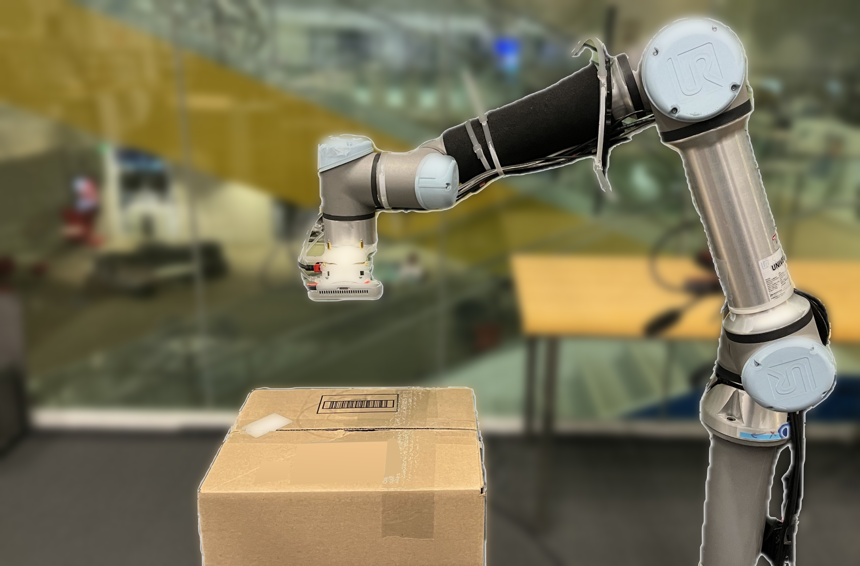
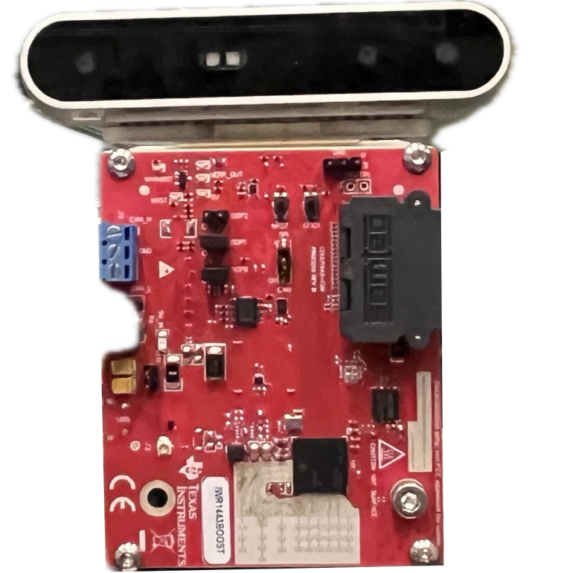
Implementation
UR5e Robot Arm
TI IWR1443Boost 77GHz Radar
Intel Realsense RGB-D camera for ground truth
Measured experiments in line-of-sight and non-line-of-sight (cardboard occlusion)
Collected experiments across 61 different everyday objects
Camera (Ground-Truth)
Robot Arm
77GHz Radar
Cardboard
Occlusion

Slide 44
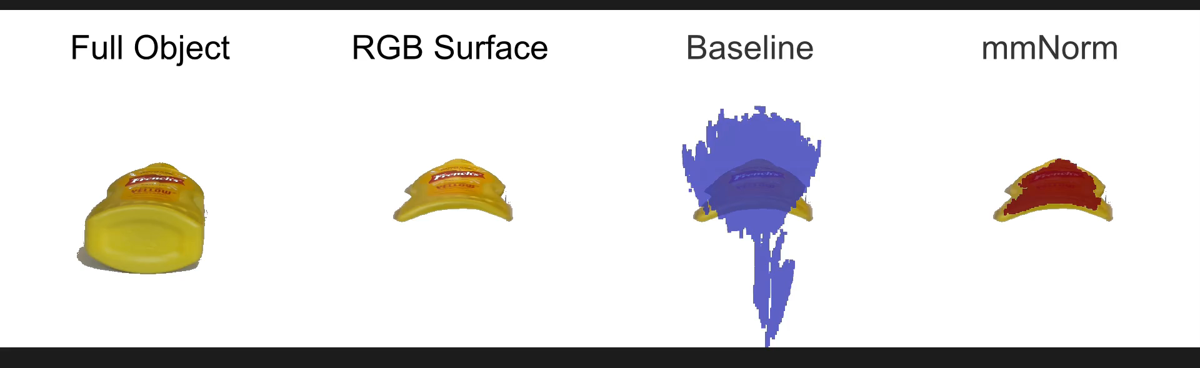
Qualitative Results
Select every voxel in SAR image above power threshold
Notes:
Of course you can increase this threshold, but you would miss many points

Slide 45
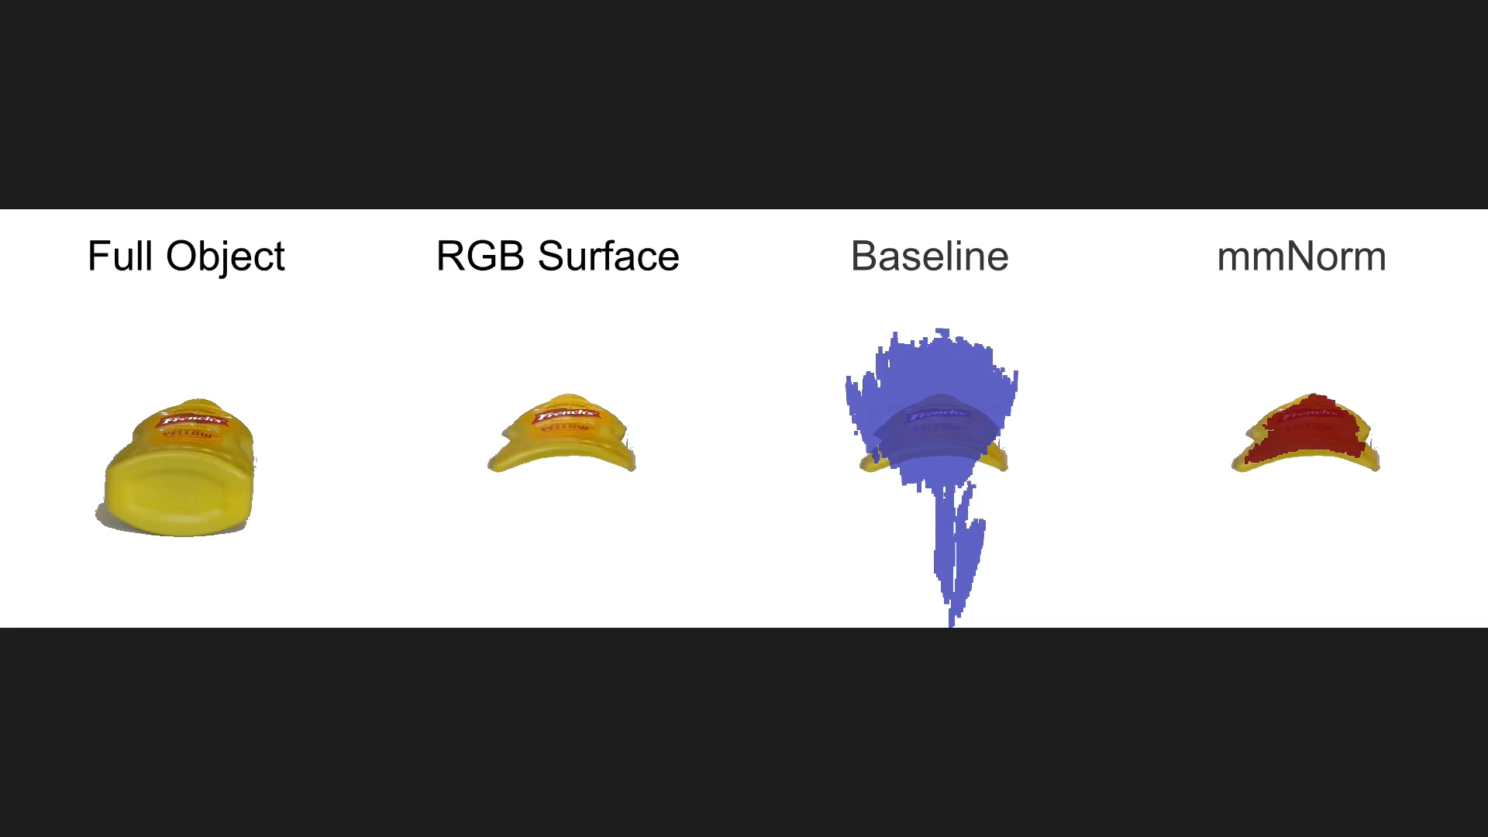
Qualitative Results

Slide 46
Qualitative Results
Measured 61 diverse everyday objects (YCB dataset)
Measure the distance from each point in the reconstruction to its nearest point in the ground truth
1.4 cm
0.25 cm

Slide 47


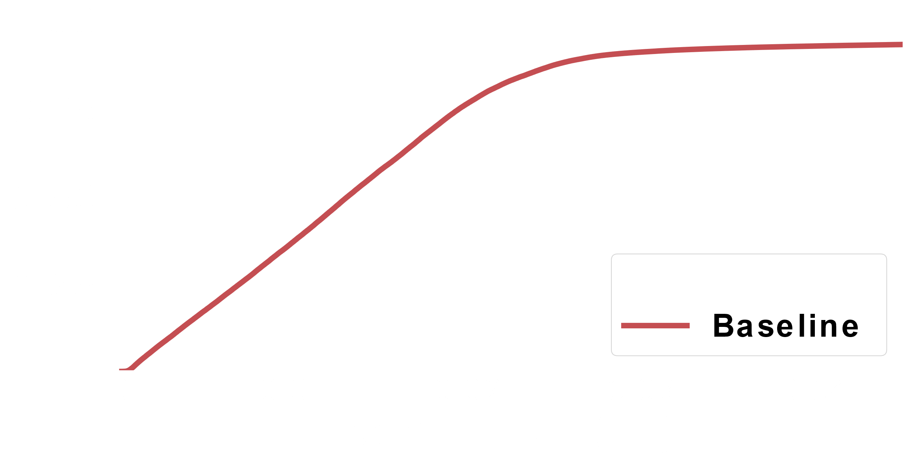
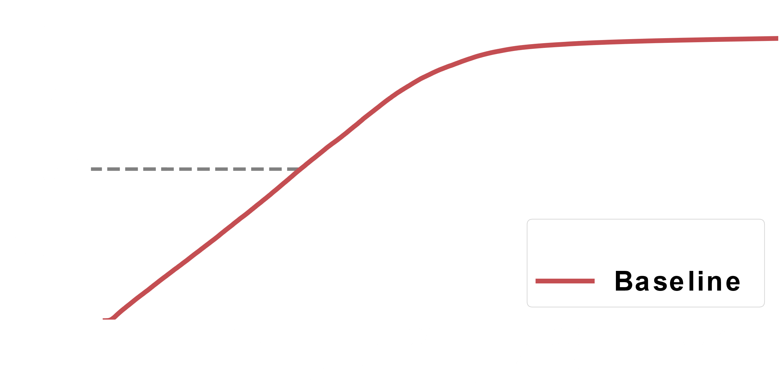


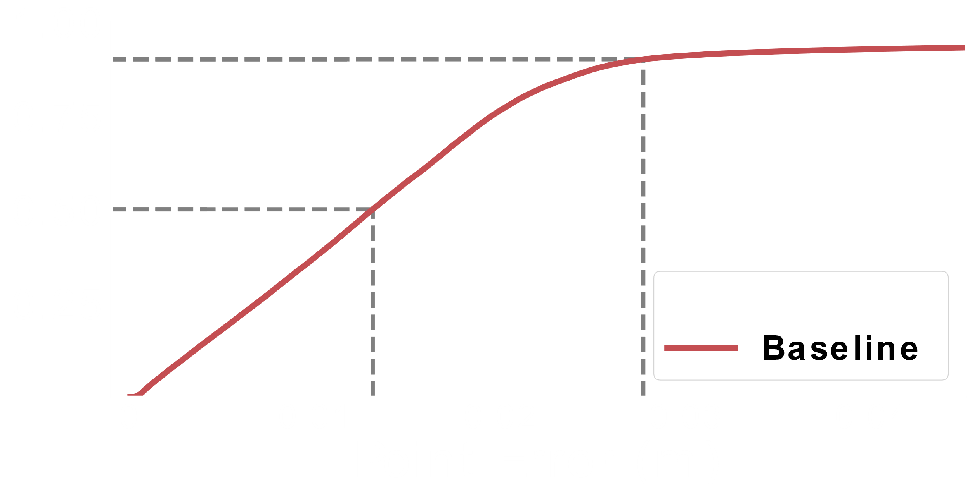
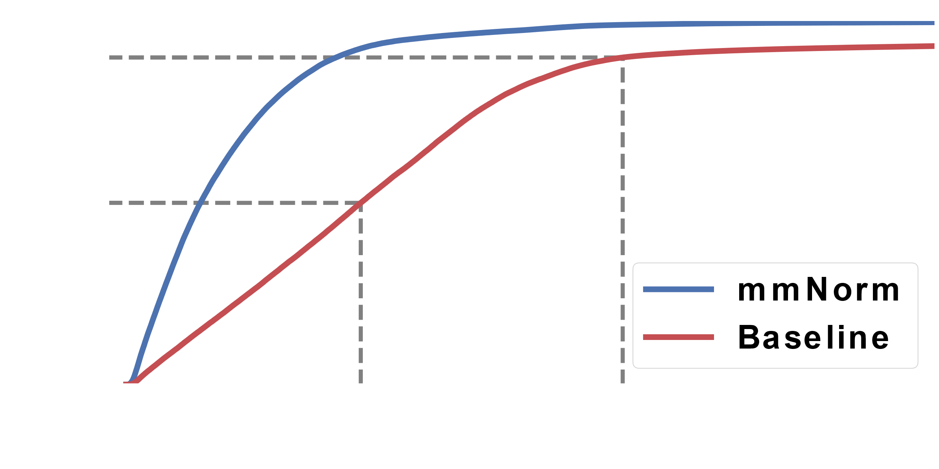
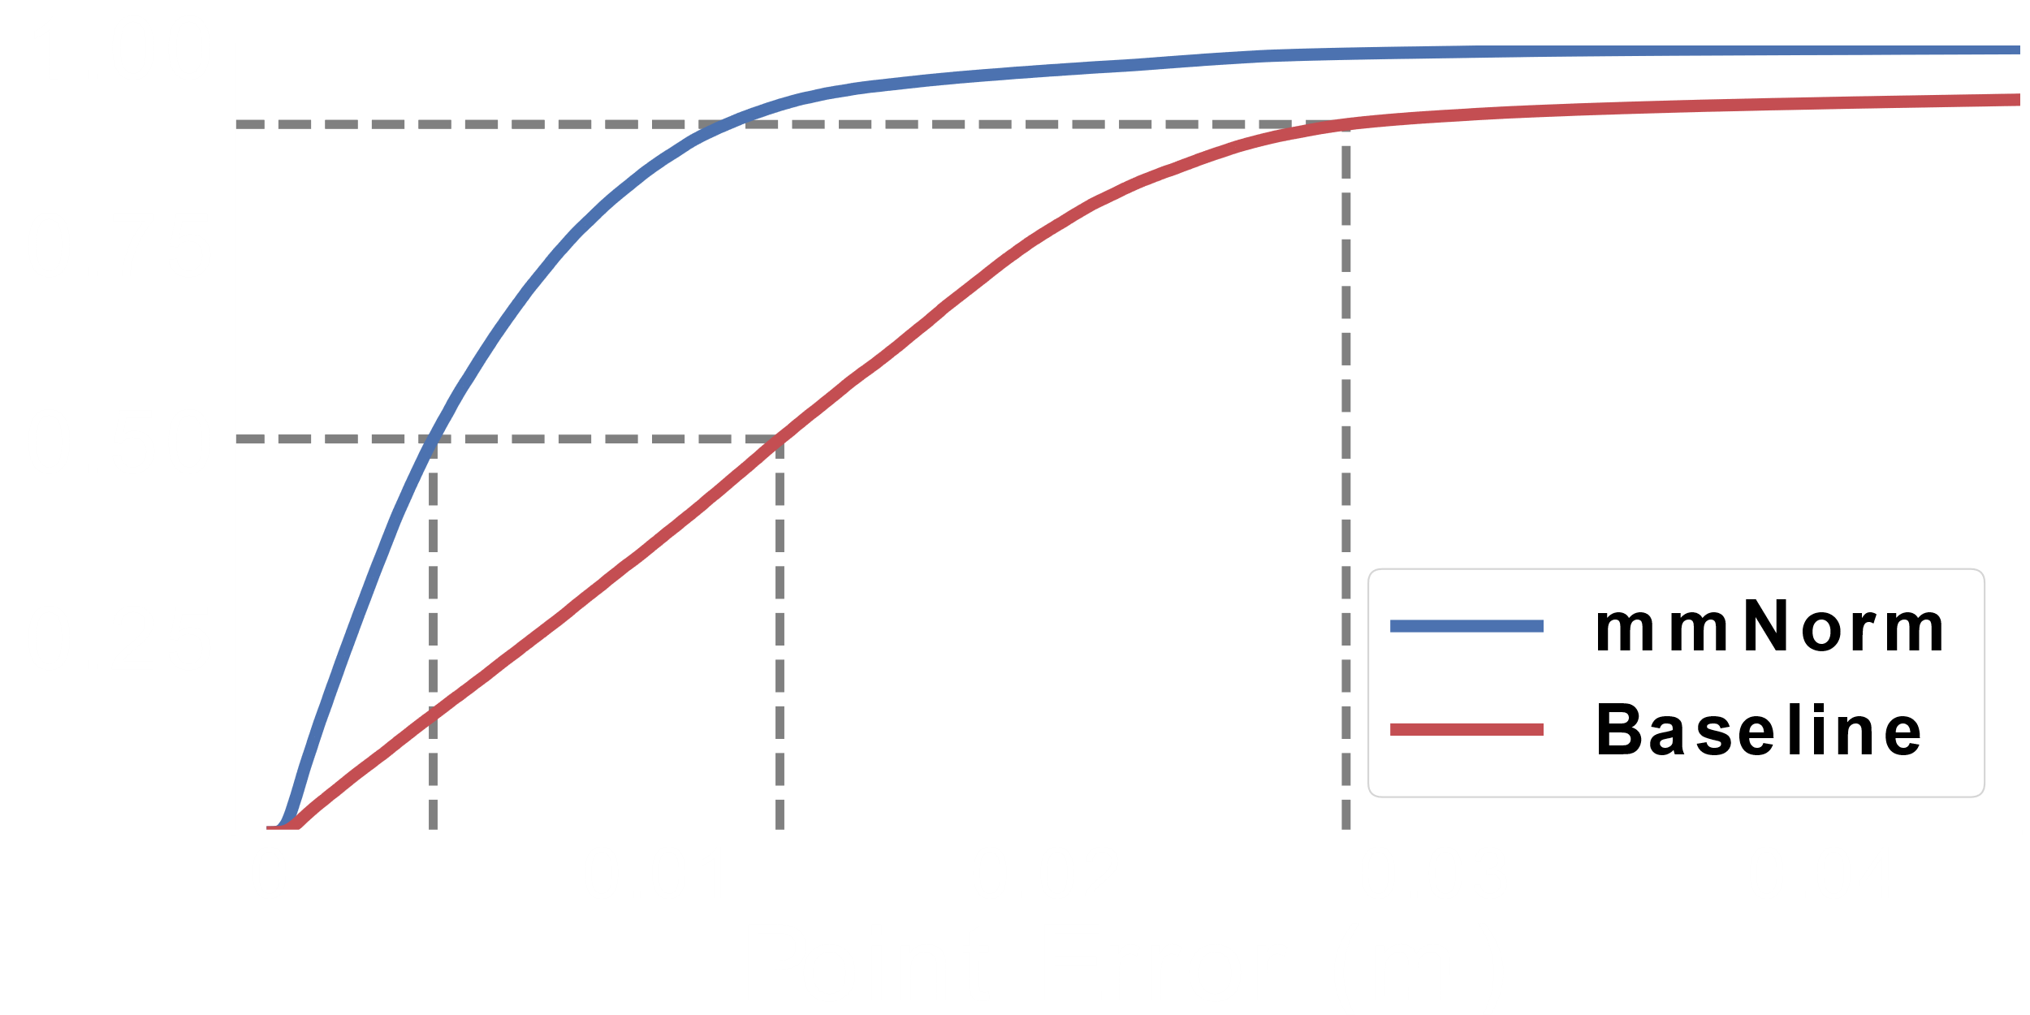

Baseline Comparison
Measure the distance from each point in the reconstruction to its nearest point in the ground truth
Compare to surface of Backprojection baseline
mmNorm is significantly outperforms
existing mmWave reconstruction methods
Notes:
mmNorm: 10: 0.0009527543254018494 50: 0.004142647134791555 90: 0.011693642799298421 Baseline: 10: 0.0028574283810214682 50: 0.013071197884985163 90: 0.02765253725247046
1cm – zig zag

Slide 48


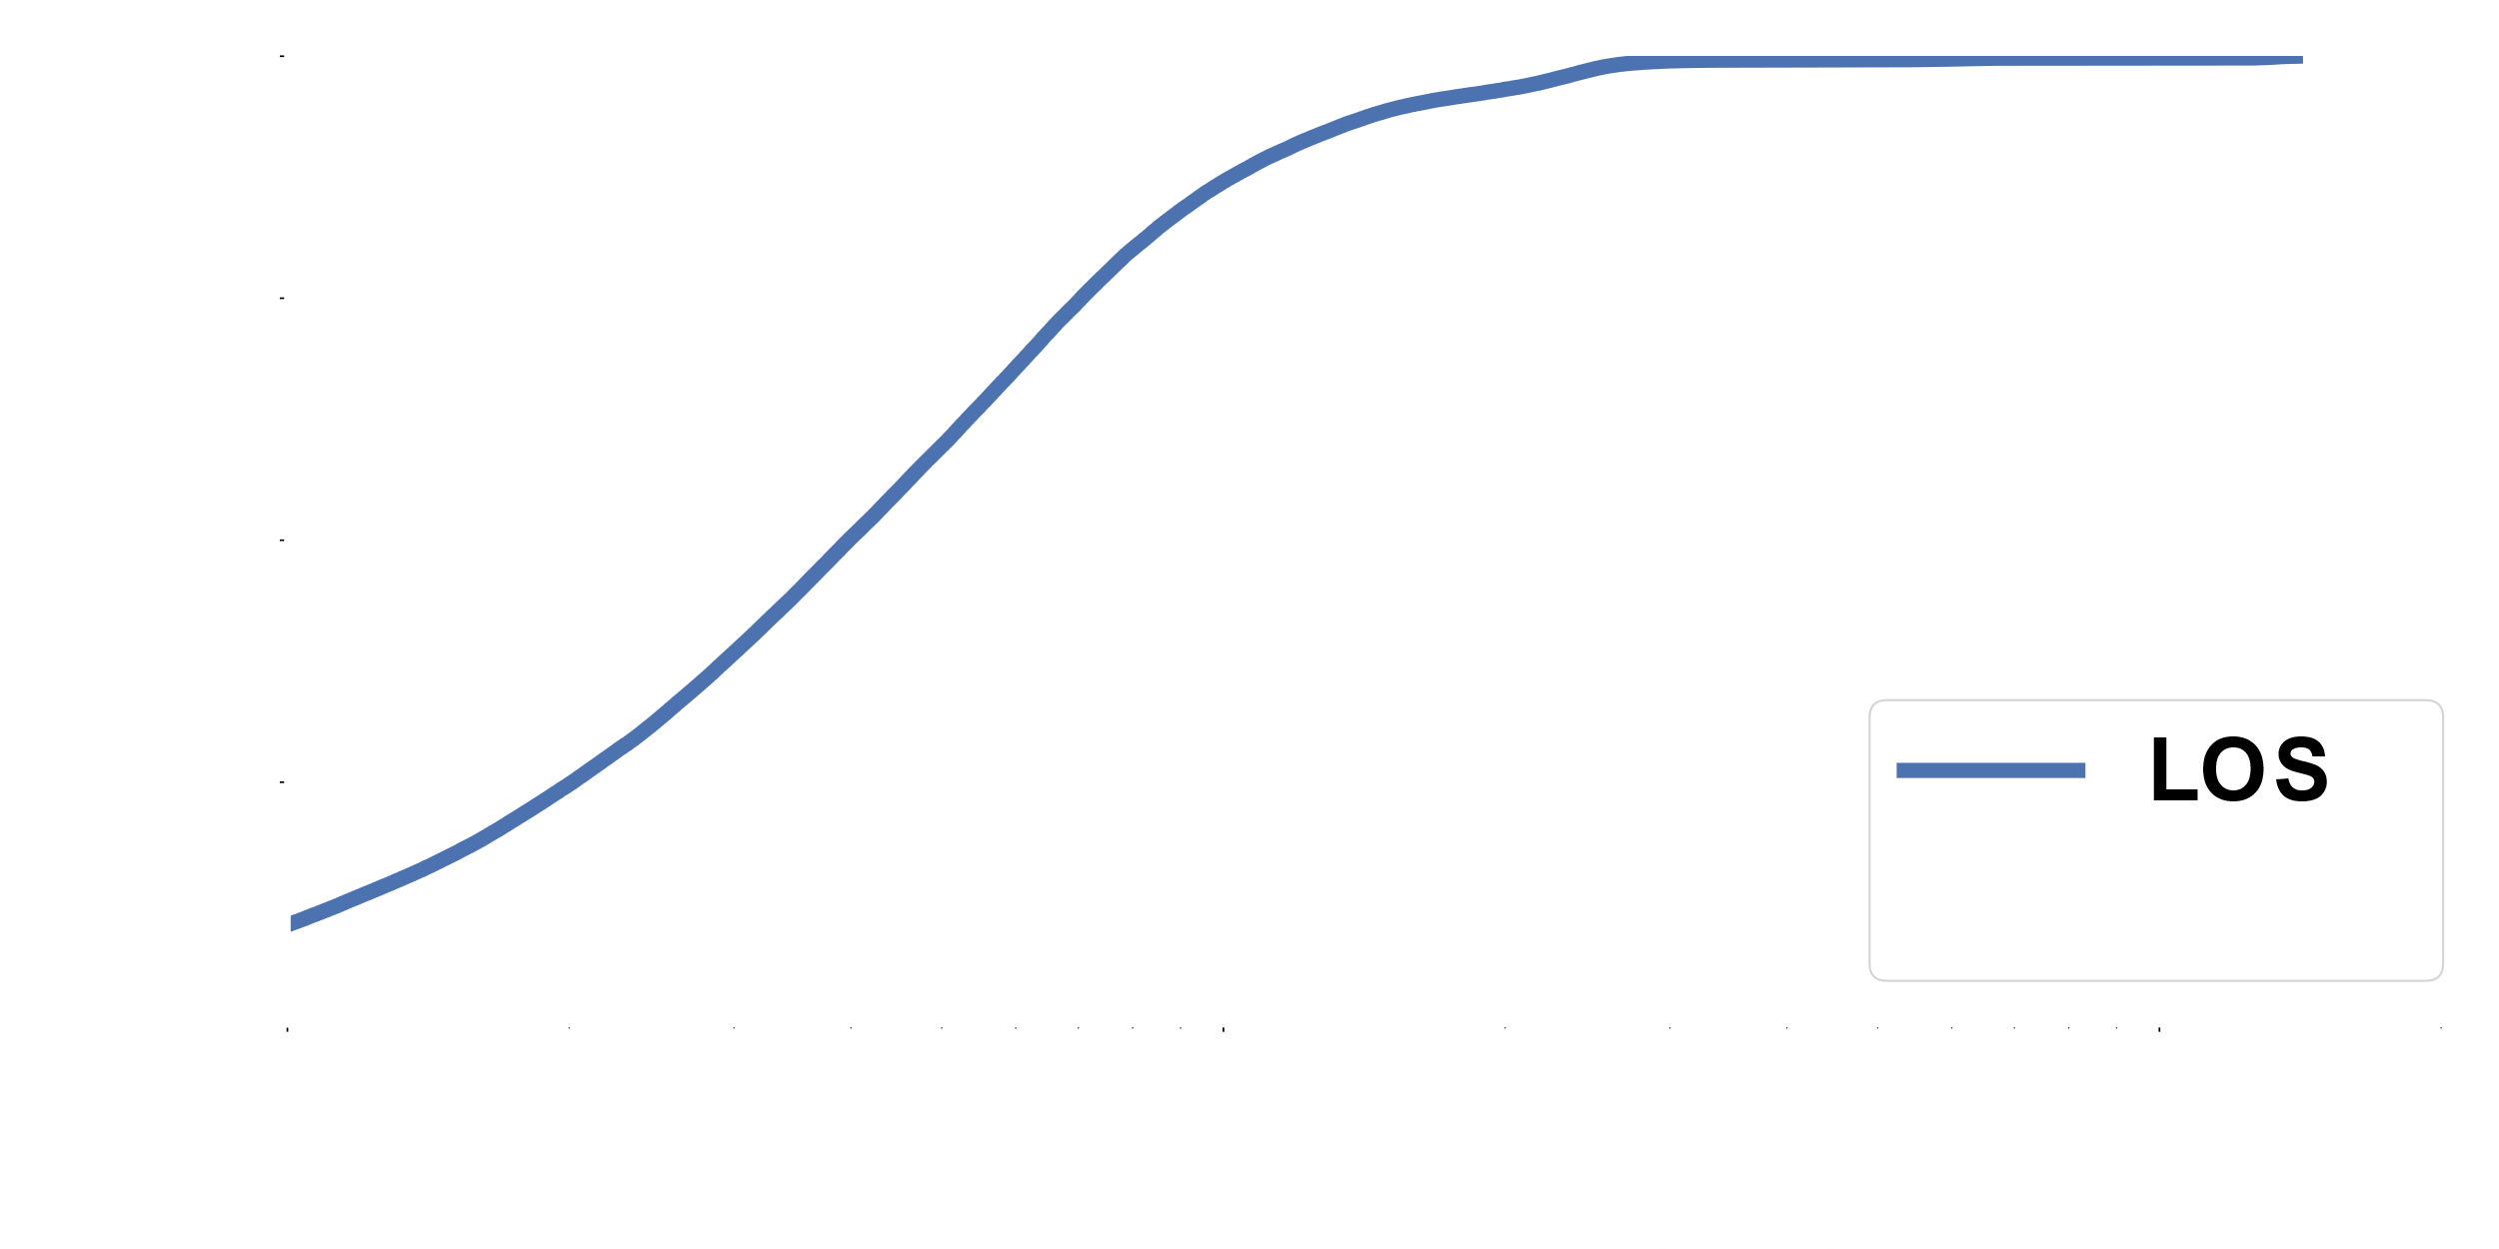
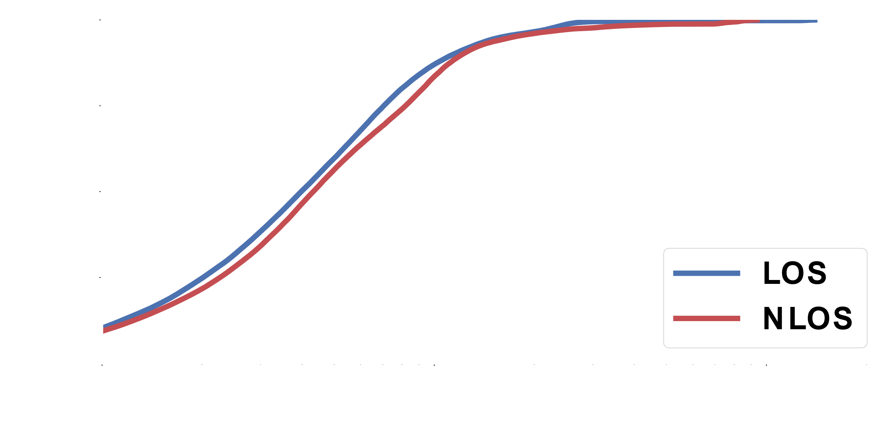
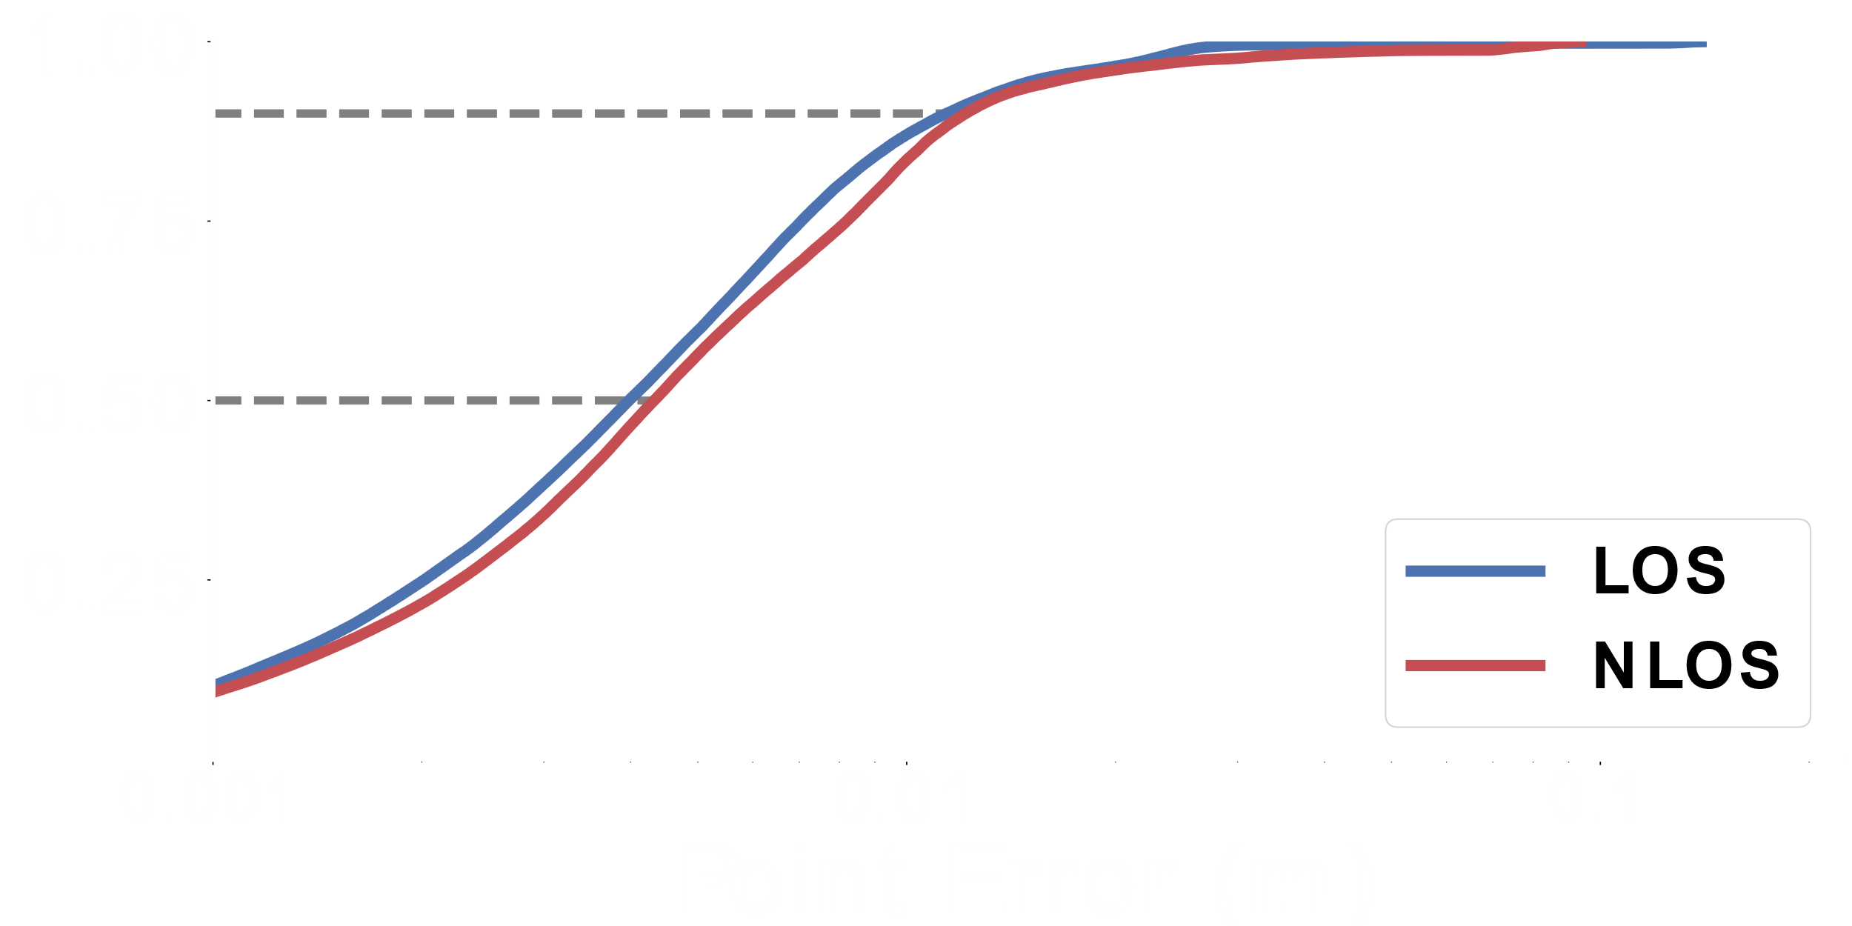

Impact of Non-Line-of-Sight
Compare performance of mmNorm in line-of-sight and non-line-of-sight (cardboard occlusion)
Measure the distance from each point in the reconstruction to its nearest point in the ground truth
mmNorm is capable of high-accuracy
non-line-of-sight reconstruction
Differs by 0.04 cm and 0.1 cm

Slide 49

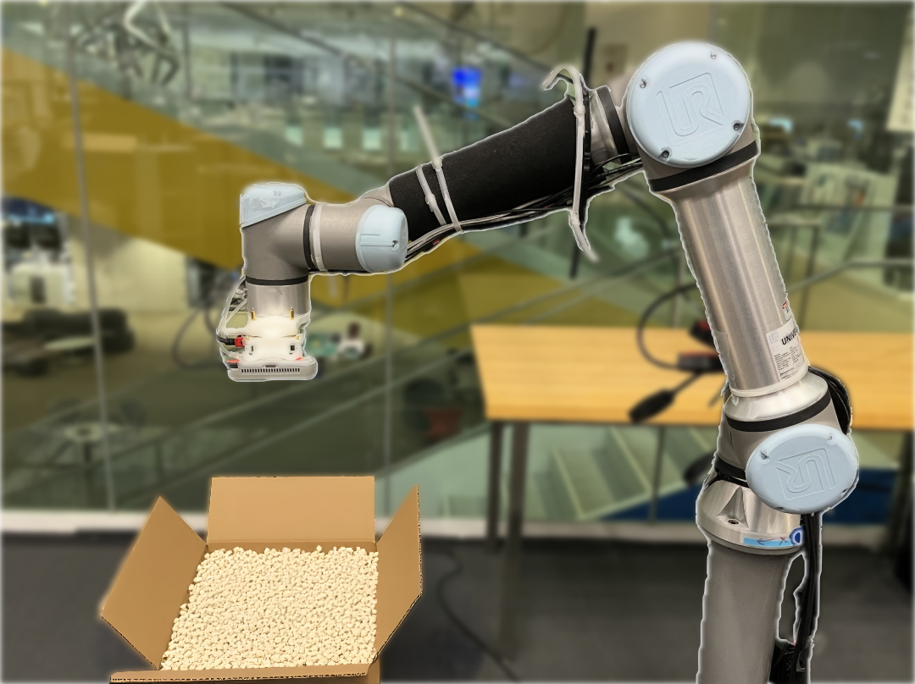
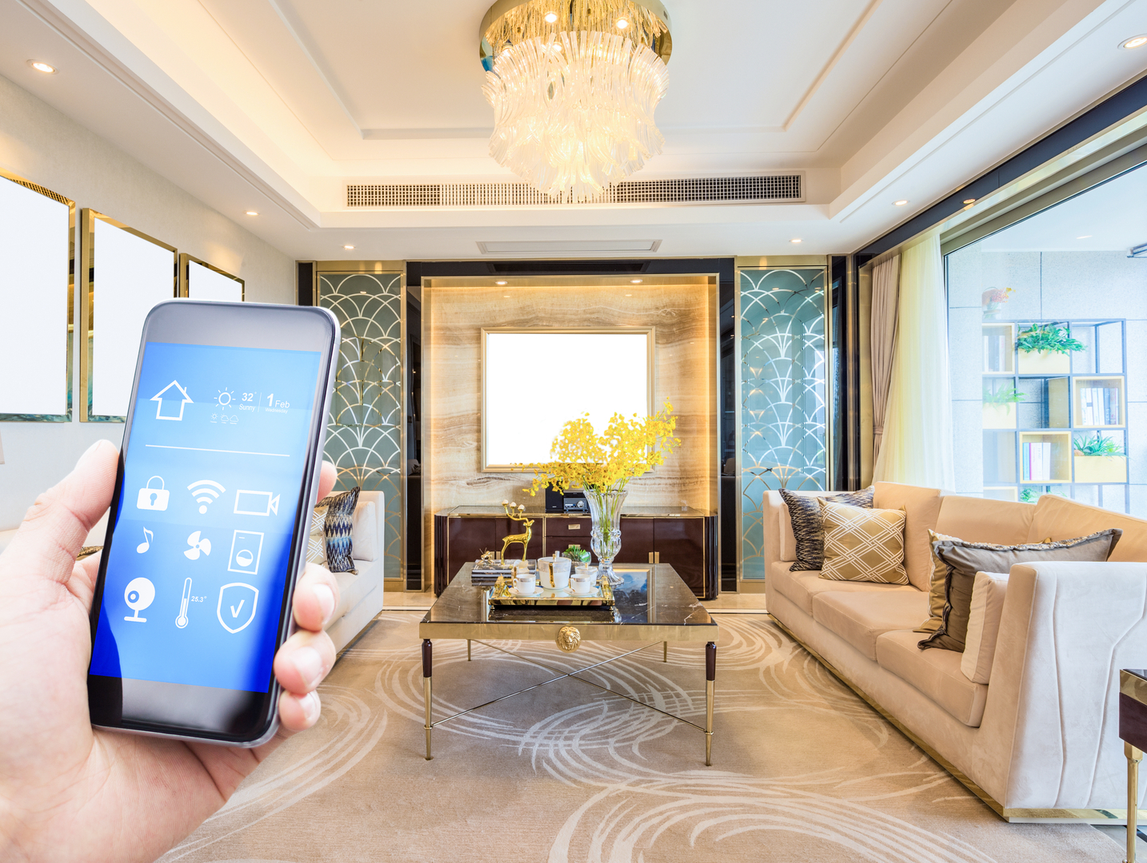
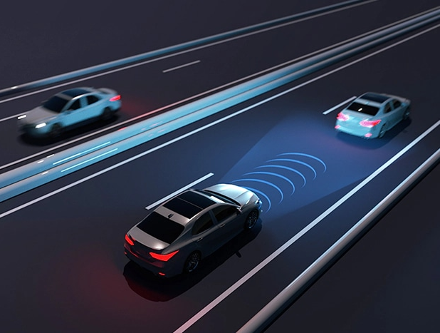
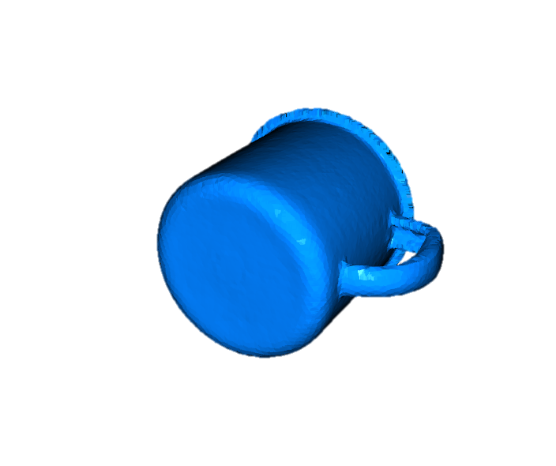
mmNorm: A paradigm shift in mmWave reconstruction
Shape Completion
Novel Downstream Tasks
Large Scale Scenes
Robotics
Indoor
Scenes
Augmented Reality
Autonomous Driving

Slide 50
mmNorm: A paradigm shift in mmWave reconstruction
Shape Completion
Novel Downstream Tasks
Large Scale Scenes
Robotics
Indoor
Scenes
Augmented Reality
Autonomous Driving

Slide 51

mmNorm: A paradigm shift in mmWave reconstruction
mmNorm Code
Shape Completion
Novel Downstream Tasks
Large Scale Scenes
Robotics
Indoor
Scenes
Augmented Reality
Autonomous Driving

